Slide 1
NXP SUMMER SCHOOL 2024
Mihai, Toader
Test Architect
June 2024

Slide 2

WHO AM I
Toader Mihai
Test Architect for Secure Software in NXP where I am leading a team for cryptographic testing (4 years)
Firmware Engineer for BTL medical devices(1 year)
System Engineer for Infineon for Smart Cards(4 years)
Product Engineer for Infineon in Body Power (2 years)
Graduated ETTI, Applied Electronics Bachelor and Advanced Electronics Masters

Slide 3
Ground RULES
There are no stupid questions!
Please be respectful to you colleagues
If you need to go to the bathroom, take a phone call, or take a small break you do not need to ask permission just leave without disturbing
Please interrupt me at any time during my presentation if you want to ask questions
Please tell me if I am going too fast or too slowly
The goal of this event is for you to understand the basic concepts, it is not for me to go through everything I have prepared
One big break from 12pm to 1pm for lunch
We will have small breaks that we can agree on

Slide 4

Embedded Systems Introduction
4
| NXP | Presentation title can go here

Slide 5
What is an embedded system?
An embedded system is a combination of
a processor,
memory,
and (input/output) peripherals
It is embedded as part of a complete device often including electrical or electronic hardware and mechanical parts.
Home appliances
Coffee machine
Washing machine
…
Industrial
RFID
Robots
…
Automotive
Engine management
Entertainment system
…
Battery management
Climate control

Slide 6
The characteristics of an embedded system
Because an embedded system typically controls physical operations of the machine that it is embedded within, it often has real-time computing constraints.
Real-time is not necessarily high performance
Other systems have low power requirements, since they depend on batteries or other limited power sources.
For example, contactless smart cards or solar powered systems.
Most devices are for mass production and hence have low-cost targets.
Like authentication chips in electronic devices or disposable public transport cards
Special operating conditions (for example automotive)
This often results in limited processing resources

Slide 7
Microcontroller versus Microprocessor
A microcontroller or MCU (microcontroller unit) is a small computer on a single integrated circuit (IC) chip. A microcontroller contains one or more CPUs (processor cores) along with memory and programmable input/output peripherals.
Microcontrollers are designed for embedded applications, in contrast to the microprocessors used in personal computers or other general-purpose applications consisting of various discrete chips.
In modern terminology, a microcontroller is similar to, but less sophisticated than, a system on a chip (SoC). An SoC may include a microcontroller as one of its components, but usually integrates it with advanced peripherals like a graphics processing unit (GPU), a Wi-Fi module, or one or more coprocessors.
Alternatively, classification is done based on CPU capabilities.

Slide 8
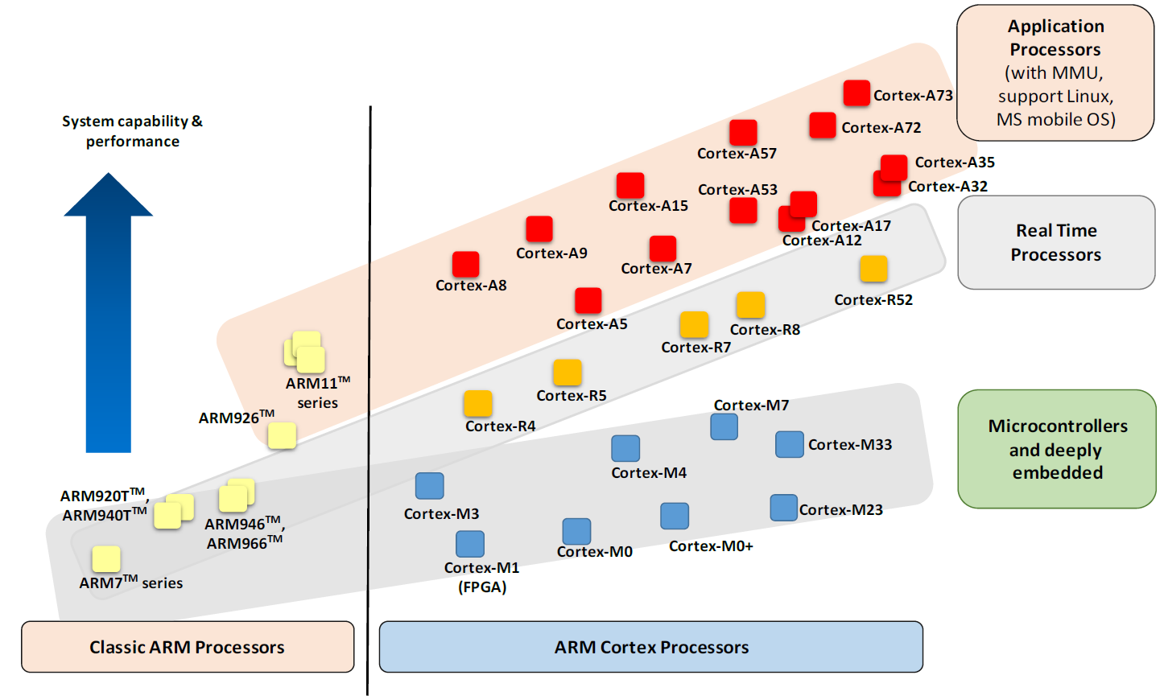
Example processor classification

Slide 9
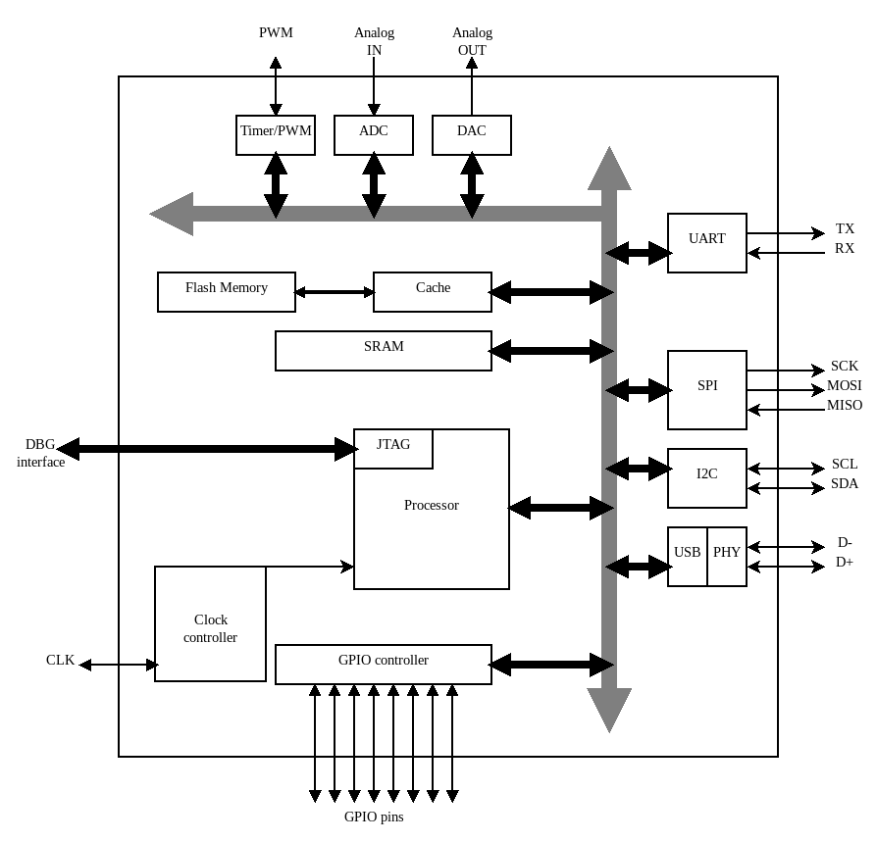
System architectures
Processor
Memories
Peripherals
Buses/Interconnects

Slide 10
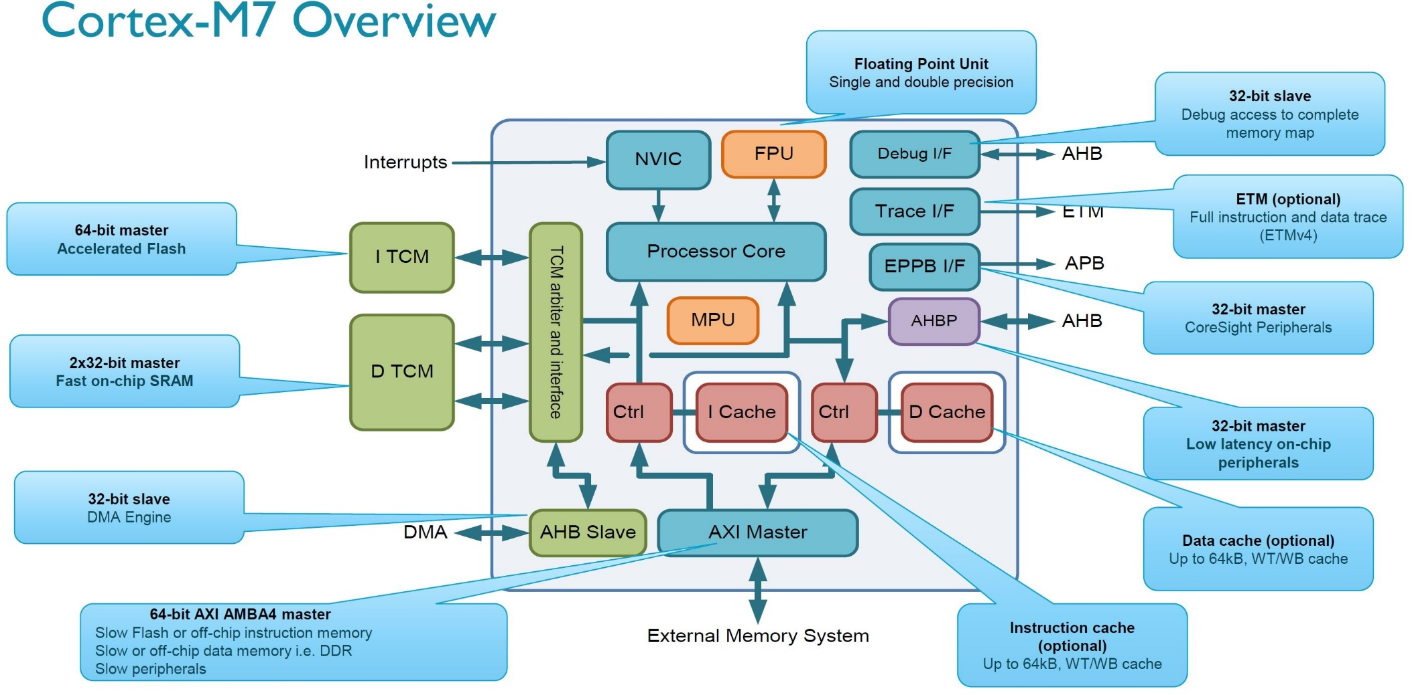
Embedded processors

Slide 11
Registers
General purpose
Internal storage/scratch area for the processor to perform its operations
Special purpose
Essential for the processor to implement control logic and code flow
Program counter: points to a location in code memory that is currently being executed
Stack pointer: points to a location in code memory that can be used for stacking register values
Link register: points to a location in code memory to jump to when returning from a routine
<status>: detailed register(s) for getting information about current processor state (last operation)
<control>: detailed register(s) for changing the processor state and/or behavior

Slide 12
Instruction sets
An instruction set defines:
the supported instructions (and their encoding [machine code]),
data types,
registers,
the hardware support for managing main memory,
fundamental features (such as the memory consistency, addressing modes, virtual memory), and
the input/output model.

Slide 13
ARM Microcontroller instruction set ARCHITECTUREs
ARMv6-M:
ARM Cortex M0/M0+/M1
ARMv7-M:
ARM Cortex M3
ARMv7E-M:
ARM Cortex M4/M7
ARMv8-M:
ARM Cortex M23/M33/M35P
ARMv8.1-M:
ARM Cortex M55
Register set is common
Registers R0-R7
accessible to all instructions
Registers R8-R12
accessible to few 16-bit instr, all 32-bit
R13 is the stack pointer
R14 is the link register
R15 is the program counter
Available instructions/features depend on the architecture version
Some features may be optional (like floating point support)

Slide 14
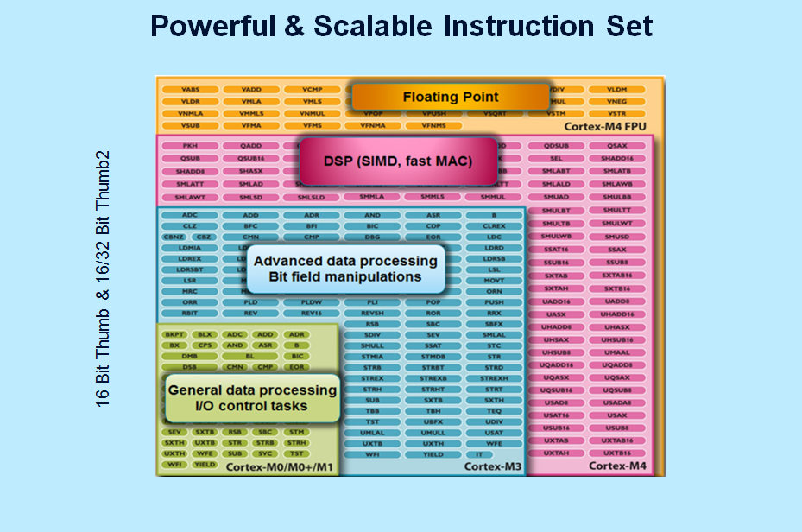

Slide 15
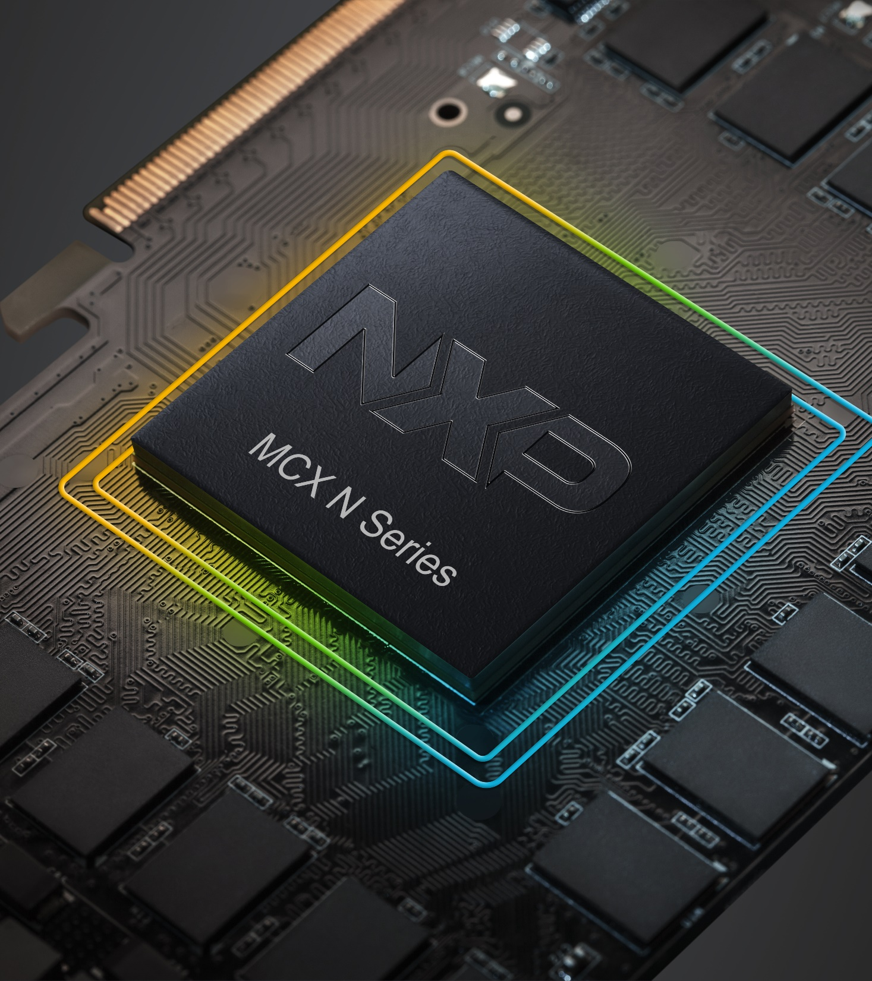
Memories
15
| NXP | Presentation title can go here

Slide 16
Memory types
Volatile storage
Registers
RAM: random-access memory
SRAM: static RAM
DRAM: dynamic RAM
Non-volatile / Persistent storage
ROM: read-only memory
EEPROM: electrically erasable programmable ROM
slower write, faster erase, byte oriented
Flash: “modern EEPROM”
faster write, slower erase, block oriented, more compact (cheaper)

Slide 17
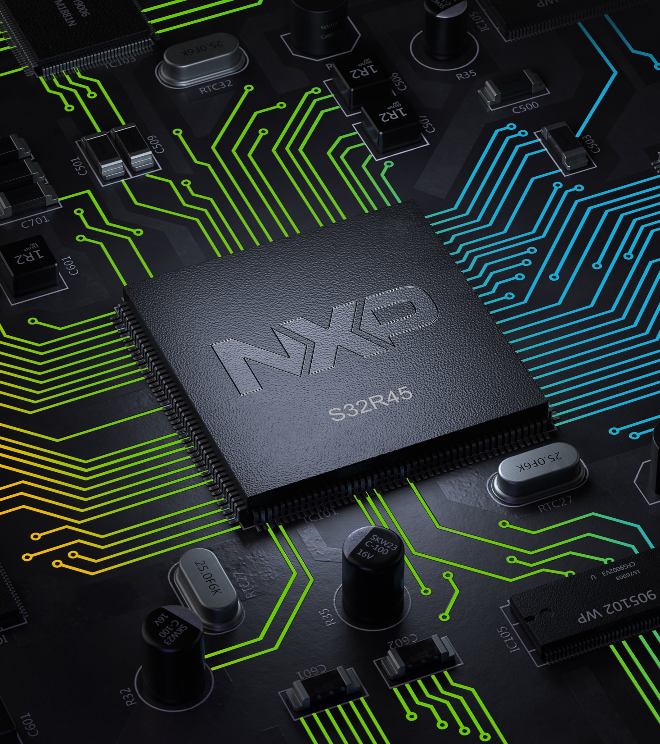
GPIO General Purpose Input Output
17
| NXP | Presentation title can go here

Slide 18
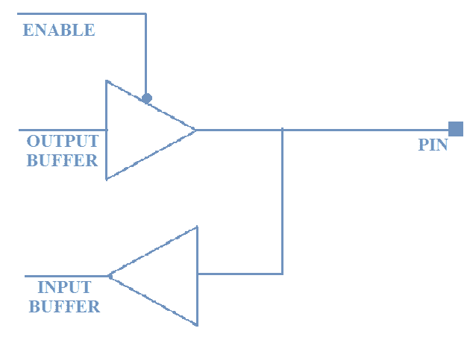
How does GPIO work internally?
A GPIO pin consists of an input buffer, an output buffer and an ENABLE pin. The value provided at the ENABLE pin decides whether the GPIO would work either as an input or an output.
The internal circuitry of the buffer is a simple CMOS logic circuit. It has a PMOS transistor connected to the +Vcc and an NMOS transistor connected to the ground as shown in fig. 4. When the ENABLE pin set to 0, the output buffer is enabled and when it is set to 1, the input buffer is enabled.
ENABLE.[0] = 0 – The Pin functions as OUTPUT pin.
ENABLE.[0] = 1 – The Pin functions as INPUT pin.

Slide 19
GPIO Modes
The GPIO can be configured either to send data from the processor to an output device or receive data from an input device and send it to the processor. But most of the GPIO’s in microcontrollers support additional functionalities; they function as an I/O pin of other peripherals for eg. Tx pin UART, MOSI pin of SPI, etc. This feature of the controller is called Alternate functionality. The ability to exhibit different functionality by the GPIO is referred to as GPIO modes.
Similarly, GPIO pins in most microcontrollers can be configured for 4 types of GPIO modes which are:
Input Mode:
Output Mode
Analog Mode
Alternate function Mod

Slide 20
Input Mode
In input mode, the data is received from an external source, this would mean reading High or Low level.
The input mode can be configured for 3 configurations which are:
Pull-Up
Pull-down
Floating point
Floating point
This state is called a HIGH impedance state, indeterminate state or high Z-state wherein the pin toggles between HIGH and LOW induced by the external noise. Here basically the pin is not connected to either to the +Vcc or the GND. Whenever a GPIO pin is not in use, it is basically in an input state with a High Impedance state. It is recommended to keep the unused pins in either pull-up or pull-down state to avoid leakage of current.
To avoid this HIGH impedance state, a pull-up or a pull-down register is introduced. Let us see what is the pull-up/pull-down configuration.

Slide 21
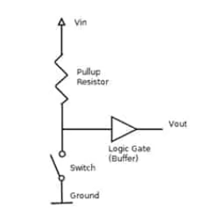
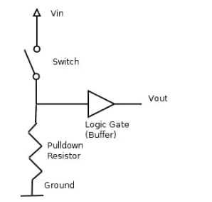
Floating point
Pull-Up:
If the input is configured for internal pull-up, then the state will be HIGH unless an external pull-down register is used. This avoids the HIGH impedance state. The figure below shows the pull-up register connected to the input buffer.
Pull-down:
If the input is configured for pull-down, then the state will be LOW unless an external pull-up register is used. This avoids the HIGH impedance state. The figure below shows the pull-down register configuration.

Slide 22
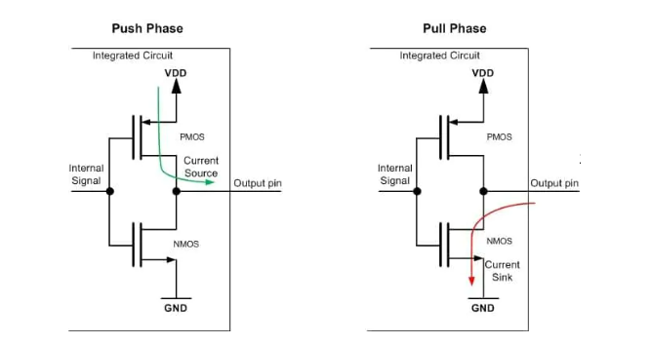
Output Mode
There are two configurations:
Push-Pull and
Open drain
Push-Pull
Here in this configuration, both NMOS and PMOS are ON/OFF to drive the output at an appropriate level. The top transistor (PMOS) is ON when the output has to drive HIGH state. The bottom transistor (NMOS) is ON when the output has to drive a LOW state. Push-pull mode is the default mode in output configuration.

Slide 23
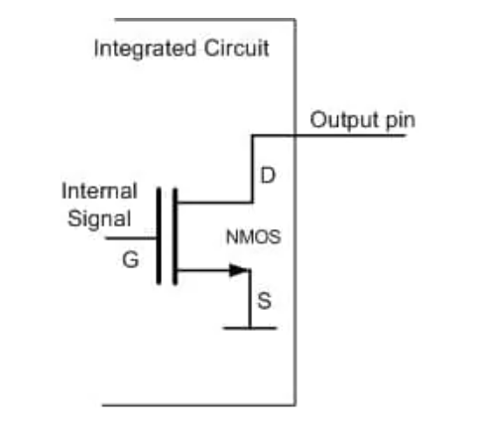
Output Mode
Open drain
In this configuration the PMOS transistor is not present, making the output to be in high impedance state. This state is useless until a pull-up resistor either internal or external.

Slide 24
Output Mode
Analog Mode
In analog mode, it allows the use of peripherals including DAC, ADC
Alternate functionality mode
GPIO pins have the capability of to provide an alternate function apart from the regular three modes. The pins are multiplexed to provide functionalities like USART Tx pin, I2C data pin, etc.

Slide 25
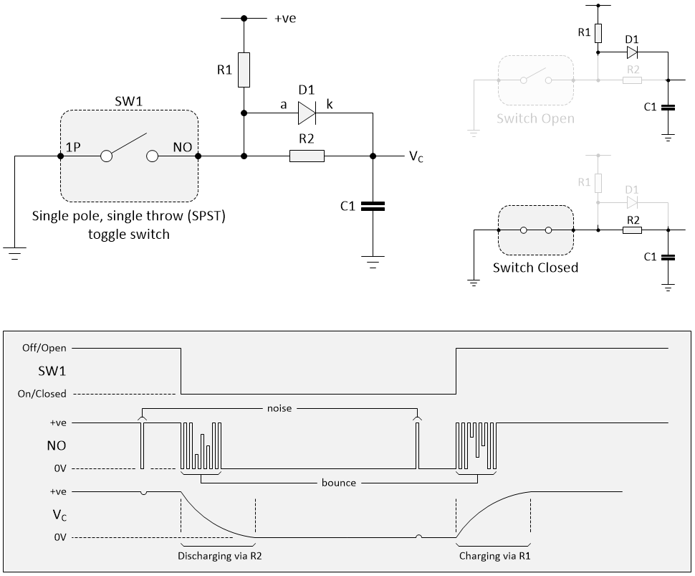
Debounce

Slide 26
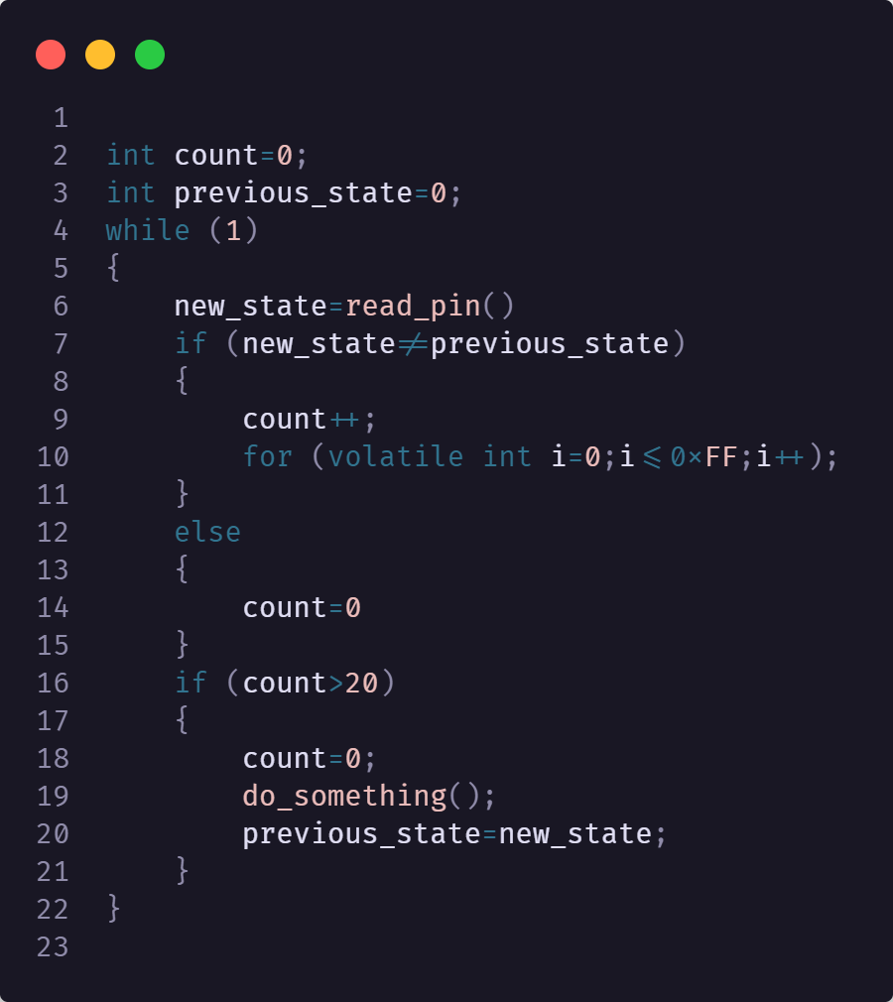
Debounce – software approach
Pseudocode for debouncing

Slide 27
C PRIMER
27
| NXP | Presentation title can go here

Slide 28
Reprezentation of data in memory
What is the output of sizeof(int)?
What about sizeof(int*)?
Embedded device will use stdint.h or similar:
Link
Data types:
int8_t
int16_t
int32_t
uint8_t
uint16_t
uint32_t
uint64_t
Etc…
There is limited use in embedded for signed operations, most of the data types encountered will be unsigned
Notes:
+ show C_representation_char/1

Slide 29
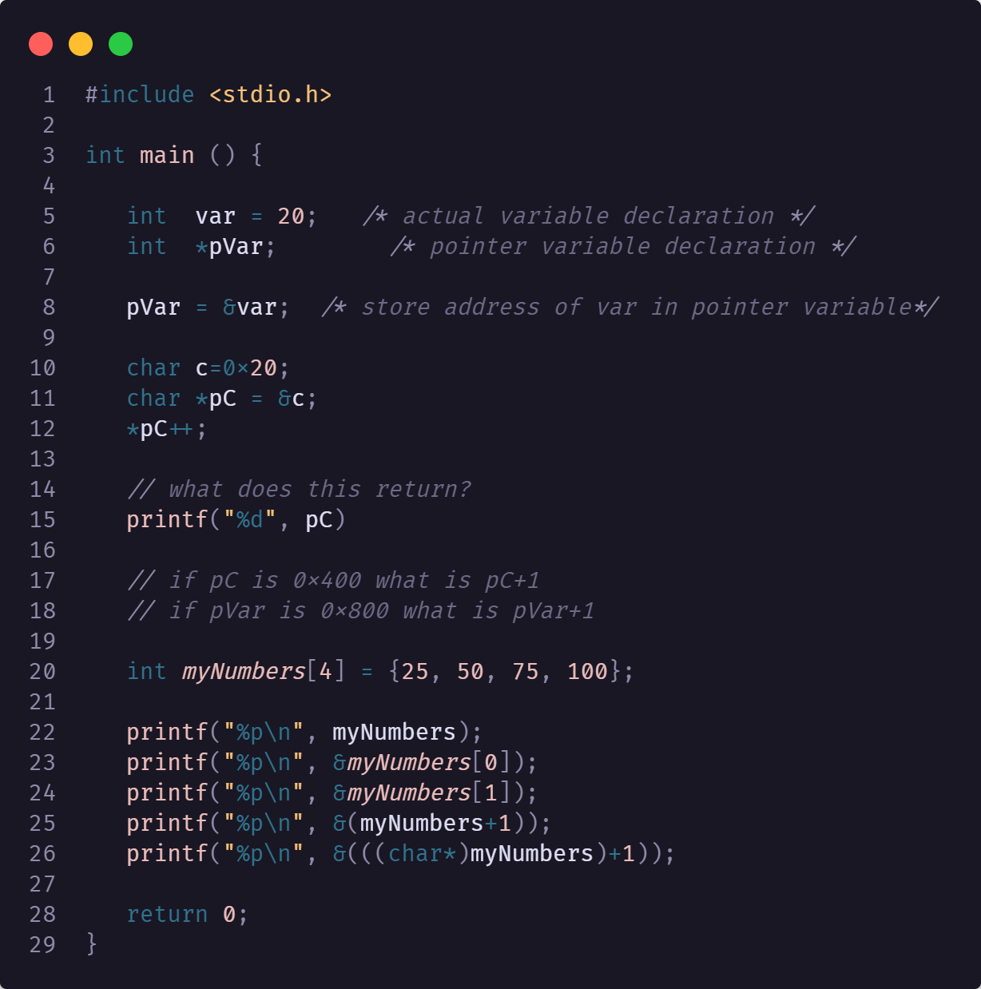
Pointers

Slide 30
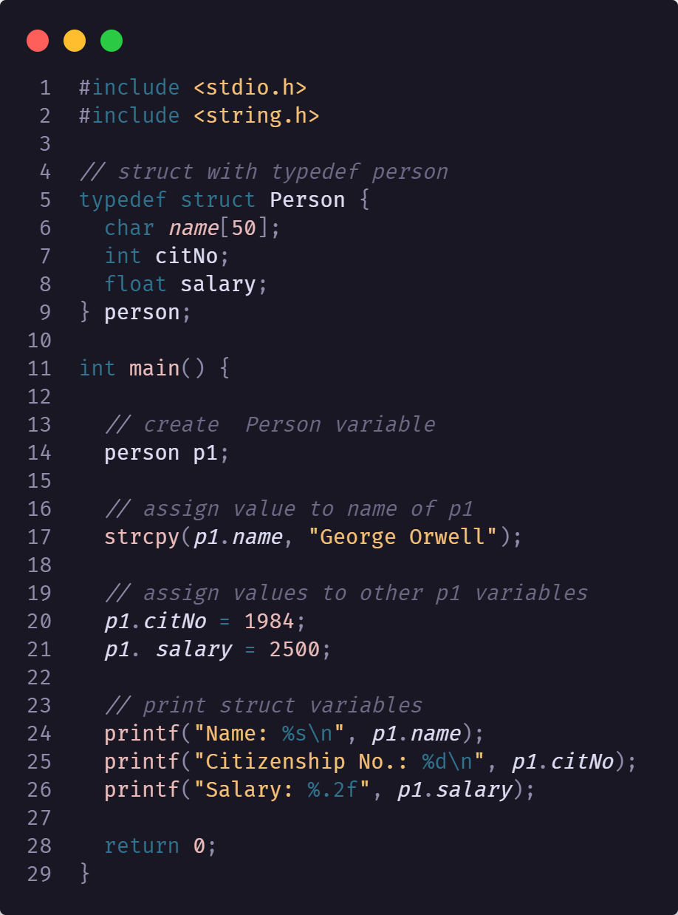
Structs
Notes:
- Use typedef structs

Slide 31
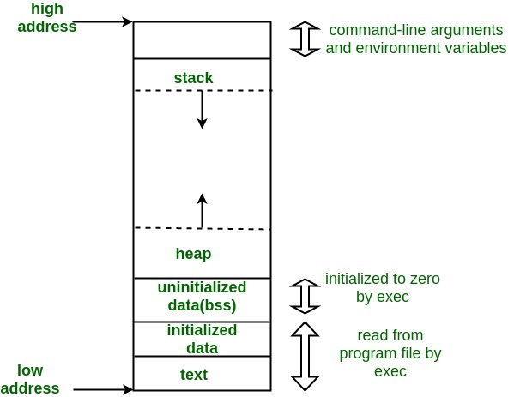
Memory zones
A typical memory representation of a C program consists of the following sections.
1. Text segment (i.e. instructions)
2. Initialized data segment
3. Uninitialized data segment (bss)
4. Heap
5. Stack
Notes:
gcc test.c -o test -Xlinker -Map=output
size test.exe

Slide 32
Memory zones
Text Segment: A text segment, also known as a code segment or simply as text, is one of the sections of a program in an object file or in memory, which contains executable instructions. The text segment is often read-only, to prevent a program from accidentally modifying its instructions.
Initialized Data Segment: Initialized data segment, usually called simply the Data Segment. A data segment is a portion of the virtual address space of a program, which contains the global variables and static variables that are initialized by the programmer. Note that, the data segment is not read-only, since the values of the variables can be altered at run time. Ex: static int i = 10 will be stored in the data segment and global int i = 10 will also be stored in data segment

Slide 33
Memory zones
Uninitialized Data Segment: Uninitialized data segment often called the “bss” segment, named after an ancient assembler operator that stood for “block started by symbol.” Data in this segment is initialized by the kernel to arithmetic 0 before the program starts executing uninitialized data starts at the end of the data segment and contains all global variables and static variables that are initialized to zero or do not have explicit initialization in source code. For instance, a variable declared static int i; would be contained in the BSS segment. For instance, a global variable declared int j; would be contained in the BSS segment.
Stack: The stack area traditionally adjoined the heap area and grew in the opposite direction; when the stack pointer met the heap pointer, free memory was exhausted. The stack area contains the program stack, a LIFO structure, typically located in the higher parts of memory. A “stack pointer” register tracks the top of the stack; it is adjusted each time a value is “pushed” onto the stack. The set of values pushed for one function call is termed a “stack frame”; A stack frame consists at minimum of a return address. Stack, where automatic variables are stored, along with information that is saved each time a function is called. Each time a function is called, the address of where to return to and certain information about the caller’s environment, such as some of the machine registers, are saved on the stack.

Slide 34
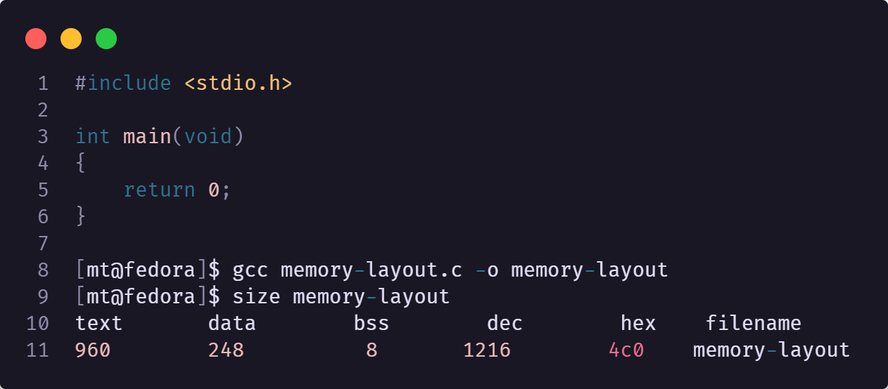
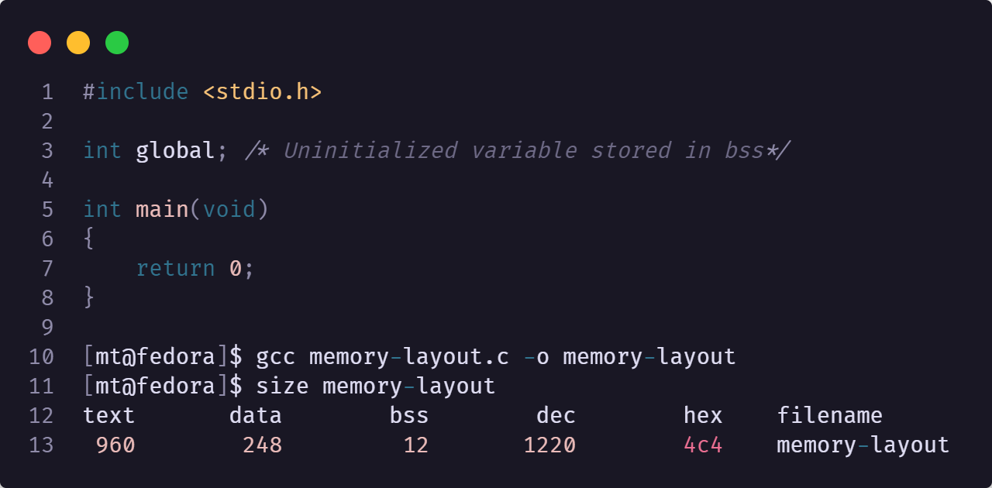
Memory zones
Heap: Heap is the segment where dynamic memory allocation usually takes place. The heap area begins at the end of the BSS segment and grows to larger addresses from there. The Heap area is managed by malloc, realloc, and free.
Notes:
https://www.geeksforgeeks.org/memory-layout-of-c-program/

Slide 35
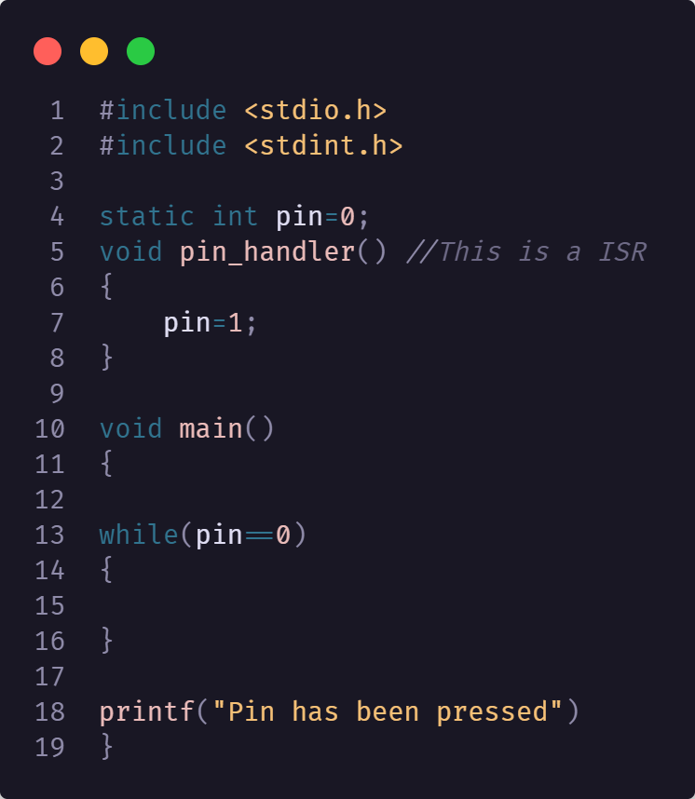
Volatile and static
What does the volatile keyword do?
What does the static keyword do?
Notes:
volatile tells the compiler not to optimize anything that has to do with the volatile variable.
There are at least three common reasons to use it, all involving situations where the value of the variable can change without action from the visible code:
When you interface with hardware that changes the value itself
when there's another thread running that also uses the variable
when there's a signal handler that might change the value of the variable.

Slide 36
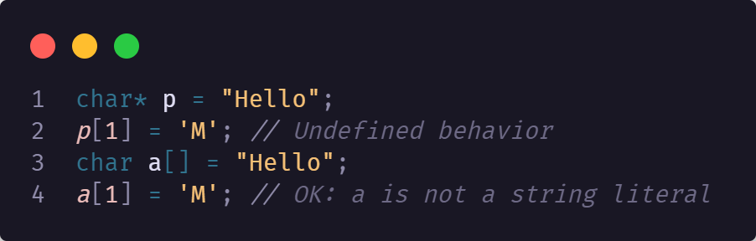
String literal
String literals are not modifiable (and in fact may be placed in read-only memory such as .rodata). If a program attempts to modify the static array formed by a string literal, the behavior is undefined.
Always try to denote string literals as such, by using const.

Slide 37
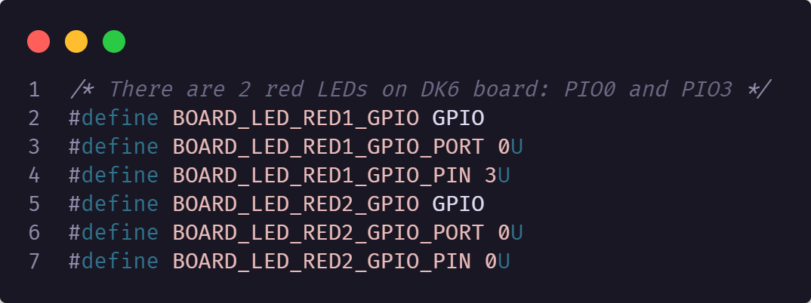
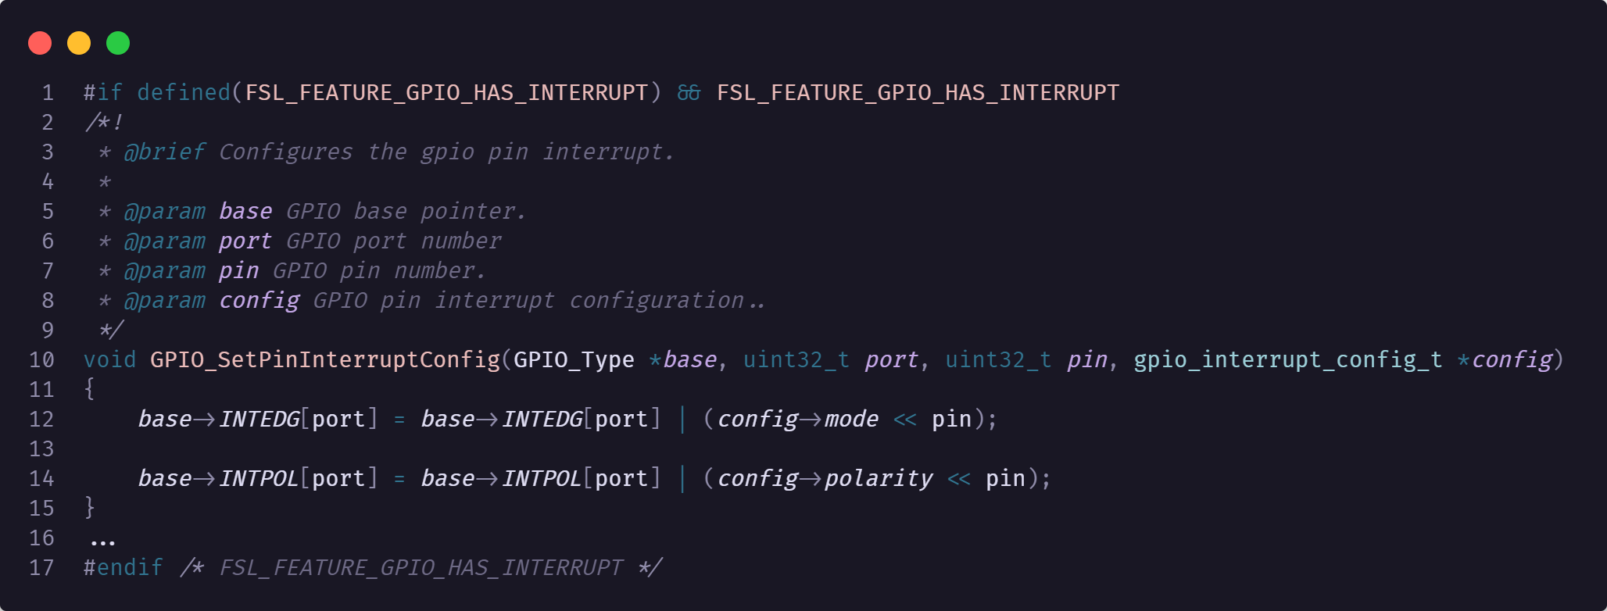
Preprocessor defines
In embedded C preprocessor defines are commonplace
They can be used to
optimize memory consumption using the #if defined or #ifdef
Can eliminate blocks of code via configuration(defined variables)
Shorthand for accessing memory/registers that is memory efficient(no need to store addresses and such in global variables)
Notes:
Show board.h

Slide 38
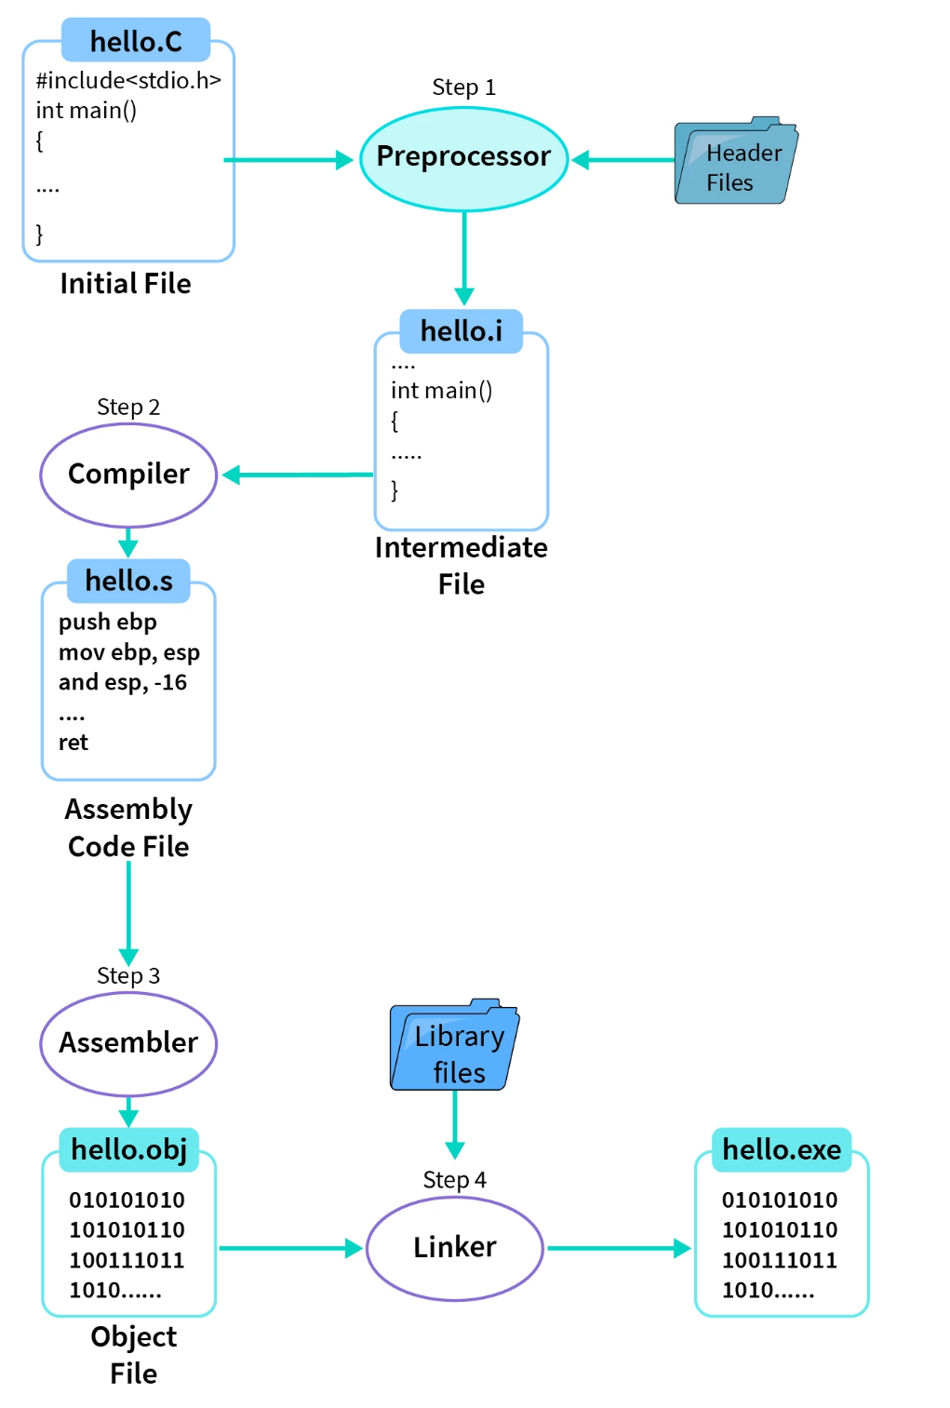
Steps in the compilation of a C program
We have a C Program file with an extension of .c i.e. hello.c file.
Step 1 is preprocessing of header files, all the statements starting with # (hash symbol) and comments are replaced/removed during the pre-processing with the help of a pre-processor. It generates an intermediate file with .i file extension i.e. a hello.i file.
Step 2 is a compilation of hello.i file. Compiler software translates the hello.i file to hello.s with assembly level instructions (low-level code).
Step 3, assembly-level code instructions are converted into machine-understandable code (binary/hexadecimal form) by the assembler. The file generated is known as the object file with an extension of .obj/.o i.e. hello.obj/hello.o file.
Step 4, Linker is used to link the library files with the object file to define the unknown statements. It generates an executable file with .exe/.out extension i.e. a hello.exe/hello.out file.
Next, we can run the hello.exe/hello.out executable file to get the desired output on our output window, i.e., Hello World!.

Slide 39
Bitwise operations
The bitwise operators in C are the following:
The & (bitwise AND) in C takes two numbers as operands and does AND on every bit of two numbers. The result of AND is 1 only if both bits are 1.
The | (bitwise OR) in C takes two numbers as operands and does OR on every bit of two numbers. The result of OR is 1 if any of the two bits is 1.
The ^ (bitwise XOR) in C takes two numbers as operands and does XOR on every bit of two numbers. The result of XOR is 1 if the two bits are different.
The << (left shift) in C takes two numbers, the left shifts the bits of the first operand, and the second operand decides the number of places to shift.
The >> (right shift) in C takes two numbers, right shifts the bits of the first operand, and the second operand decides the number of places to shift.
The ~ (bitwise NOT) in C takes one number and inverts all bits of it.
What is the functionality of || and && ?
Exercise with register setting/resetting/reading

Slide 40

Interrupts
40
| NXP | Presentation title can go here

Slide 41
Interrupts
A hardware interrupt is a signal that stops the current program forcing it to execute another program immediately. The interrupt does this without waiting for the current program to finish. It is unconditional and immediate which is why it is called an interrupt - it interrupts the current action of the processor.
An interrupt occurs independently of main code operation. So the processor can be doing other things before and after the interrupt. During the interrupt, main code operation is suspended and all registers are saved so that after the interrupt main code starts up exactly where it was.
It is as if the main code operates as usual but the interrupt operates without the main code noticing!
Notes:
https://www.best-microcontroller-projects.com/hardware-interrupt.html

Slide 42
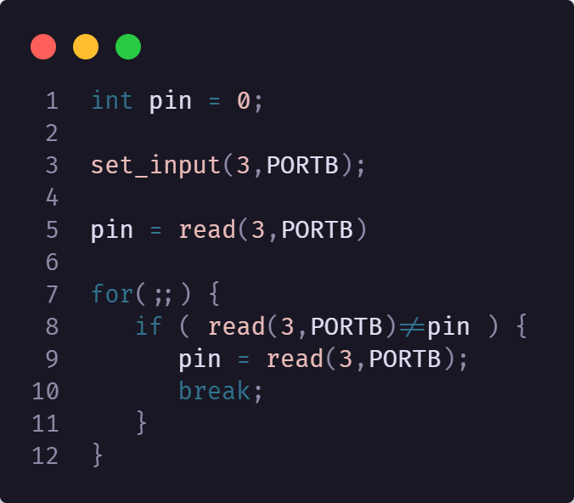
Polling
When you first start creating a program it is easy to read an input directly from an input pin using a simple read command. As you develop the program you will want to know when the input has changed and to do that you will put the read command into a loop and wait until the input pin has changed state.\
The following pseudocode illustrates the idea:
This is an example of polling and you can see that the problem with polling is that the processor can do nothing else while it is waiting for the input pin to change state.
That is the advantage of interrupts - a program can be doing something completely different and does not waste processing power in a useless loop.
Another benefit of using interrupts is that in some processors you can use a wake-from-sleep interrupt. This lets the processor go into a low power mode, where only the interrupt hardware is active, which is useful if the system is running on batteries.

Slide 43
Hardware interrupt Common terms
Terms you might hear associated with hardware interrupts are ISR, interrupt mask, non maskable interrupt, an asynchronous event, interrupt vector and context switching.
ISR | Interrupt Service Routine
Interrupt Vector | The address that holds the location of the ISR
NMI | Non Maskable Interrupt - an interrupt that is always active
Asynchronous event | An event that could happen at any time
Context switching | Saving/restoring data before and after the ISR

Slide 44
INTERRUPTS
ISR
An ISR is simply another program function. It is no different to any other function except that it does context switching (saving/restoring processor registers) and at the end of the function it re-enables interrupts.
After the ISR finishes program execution returns to the original program and it continues exactly from where it was interrupted. The original program will have no idea that this has happened.
Hardware Interrupt vector
This is a fixed address that contains the location of your ISR. In other micros there may be an interrupt vector for each vector – you have to make an interrupt routine for each one that you want to use.
You program the interrupt address with the address of your interrupt routine. Whenever the interrupt is triggered (and if the interrupt is unmasked) program operation jumps to the location of your interrupt routine.

Slide 45
Interrupts
NMI
The NMI is exactly the same as a normal interrupt except that you can not control whether or not it is active - it's always active. It is more commonly found on older/larger processors as a dedicated input pin. In this case it is more than likely fed with a brown-out-detector (BOD) circuit i.e a PSU voltage dip detector circuit - for detecting a condition that should never be ignored!
Context switching
This means that the register state is preserved at the start of an ISR and restored at the end of an ISR. It ensures that the function that was interrupted is not affected by the ISR.
Interrupt flags
Each hardware interrupt source has an associated interrupt flag - whenever the interrupt is triggered the corresponding interrupt flag is set. These flags are usually stored as bits within an interrupt register.
The processor can read from and write to the interrupt register, reading from it to find out which interrupts occurred and writing to it to clear the interrupt flags.

Slide 46
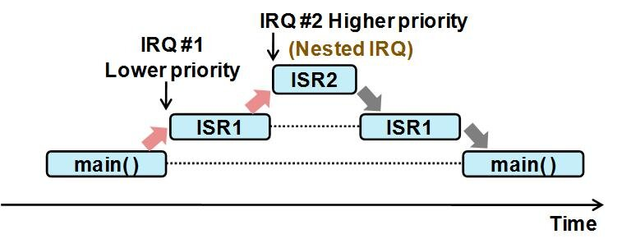
Interrupts
Hardware interrupt vector
The interrupt vector is a location in memory that you program with the address of your interrupt service routine (ISR). Whenever an unmasked interrupt occurs program execution starts from the address contained in the interrupt vector.

Slide 47
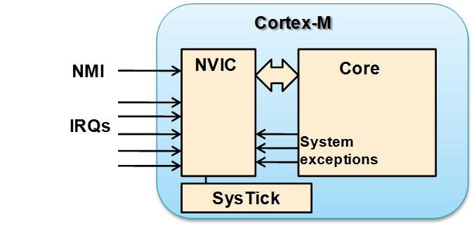
NVIC
The Nested Vector Interrupt Controller (NVIC) in the Cortex-M processor family is an example of an interrupt controller with extremely flexible interrupt priority management. It enables programmable priority levels, automatic nested interrupt support, along with support for multiple interrupt masking, whilst still being very easy to use by the programmer
Notes:
https://community.arm.com/arm-community-blogs/b/architectures-and-processors-blog/posts/beginner-guide-on-interrupt-latency-and-interrupt-latency-of-the-arm-cortex-m-processors

Slide 48
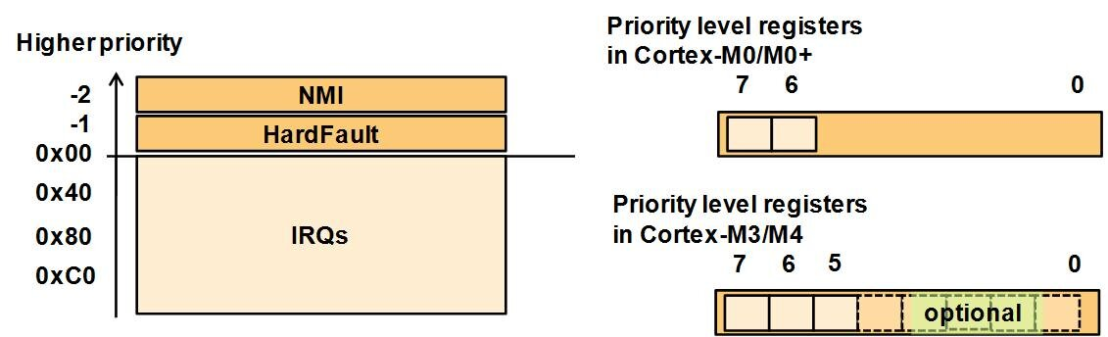
NVIC
In addition to the interrupt requests from peripherals, the NVIC design supports internal exceptions, for example, an exception input from a 24-bit timer call SysTick, which is often used by the OS. There are also additional system exceptions to support OS operations, and a Non-Maskable Interrupt (NMI) input. The NMI and HardFault (one of the system exceptions) have fixed priority levels.

Slide 49
TIMER
49
| NXP | Presentation title can go here

Slide 50
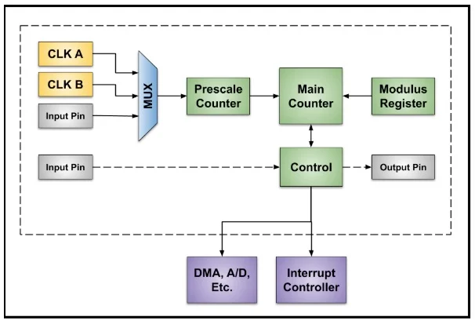
TIMER
A timer is a specialized type of clock which is used to measure time intervals. A timer that counts from zero upwards for measuring time elapsed is often called a stopwatch. It is a device that counts down from a specified time interval and used to generate a time delay, for example, an hourglass is a timer.
Every timer needs a clock source or timebase. There are often several possible clock sources and one is selected with a switch or multiplexer. Sometimes an external clock source is an option. To increase the count range, the selected clock goes to a “prescaler” which divides the clock before it goes to a main counter. The dividing factor of the prescaler is usually limited to powers of 2. The count range of the main counter is set by a “modulus” value (M) stored in a register.

Slide 51
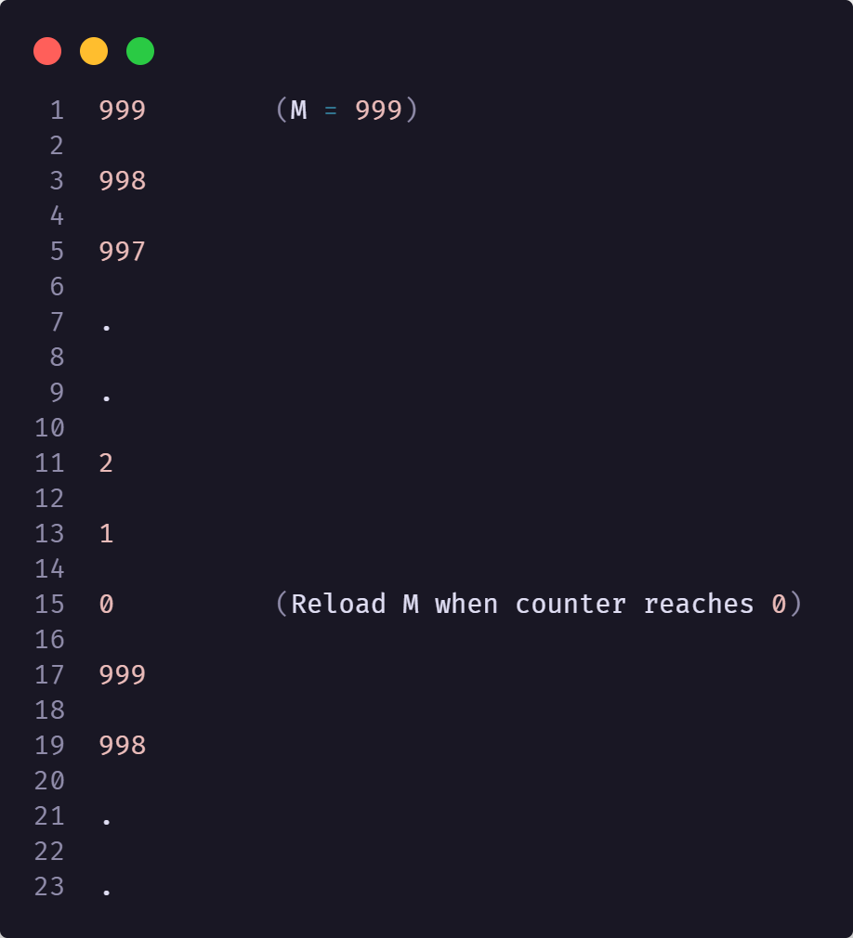
TIMER FOR M=999
Notice how the number of count states is M + 1 or 1,000 because of the “0” state. Be sure to check out the modulus load characteristics of a timer.

Slide 52
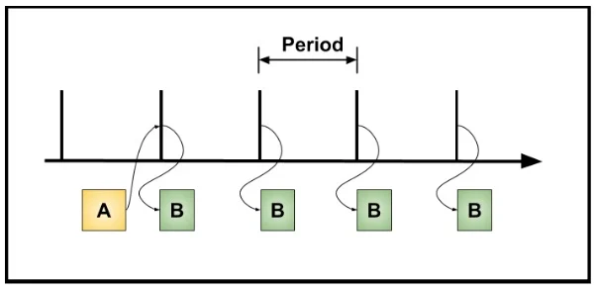
Periodic Timers
A periodic timer is great for learning about timers. They are relatively simple and not too hard to observe with a debugger. Periodic timers produce repetitive markers or “ticks” with a fixed period as shown here. The major parameter is the period which is set with a counter modulus.
“A” causes an action “B” to occur periodically under tight control of the timer. Some examples are
Controlling the polling of digital inputs like pushbuttons
Scheduling of tasks by a real-time operating system

Slide 53
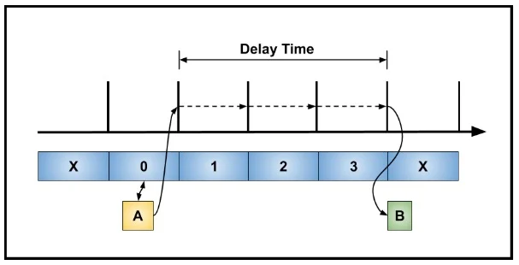
Delay TIMER
Delay functions cause something to happen after a period of time has elapsed. The diagram shows “A” resetting a timer to 0 and starting a delay of three ticks before “B” happens.
An example of delay is debouncing a pushbutton. An initial press of a pushbutton is detected by polling an input, or there is an interrupt. Then, a delay is started by “A” to wait for any mechanical bounce of the pushbutton to end. After the delay, the pushbutton is sampled again in “B”. If the pushbutton is still active, a valid button press is detected. Using a timer for the delay allows the processor to do other things during the debounce time and the delay is accurate and repeatable.

Slide 54
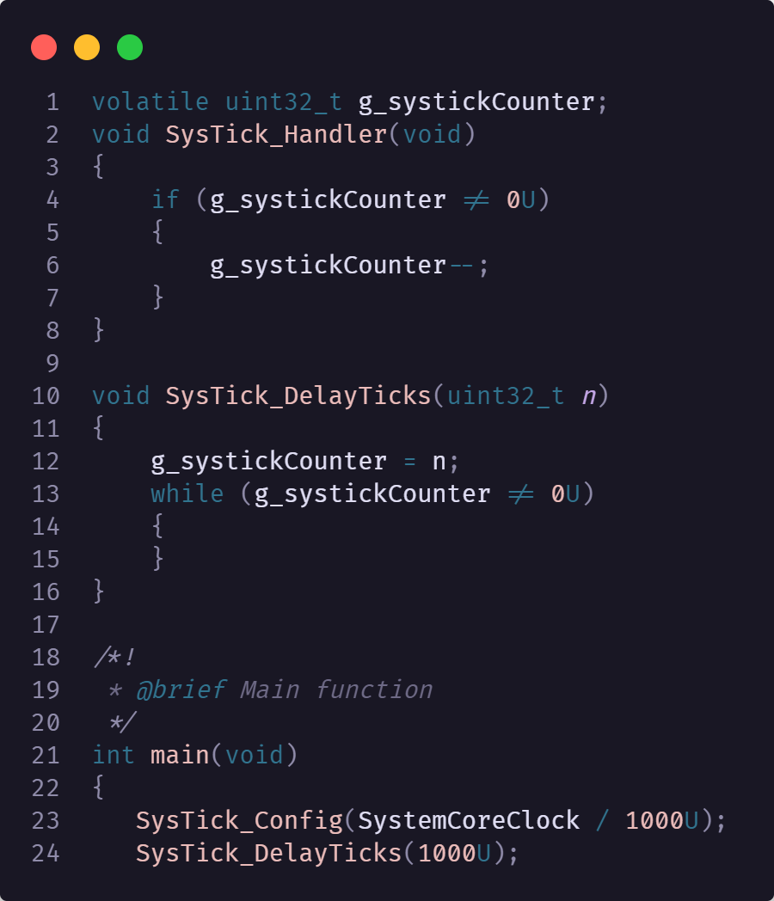
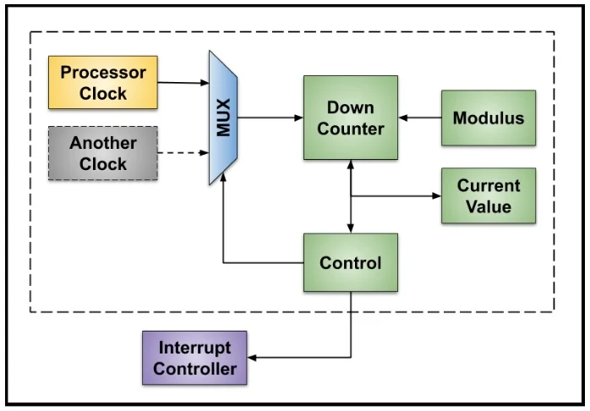
Systick
I want to illustrate one periodic timer in more detail. The simplest I know is the “SysTick timer” or, simply, SysTick. The SysTick timer is an option included with some ARM processors used as the core of many 32-bit microcontrollers. Here is a diagram of the SysTick timer.
Notes:
https://www.keil.com/pack/doc/CMSIS/Core/html/group__SysTick__gr.html

Slide 55
PWM
55
| NXP | Presentation title can go here

Slide 56
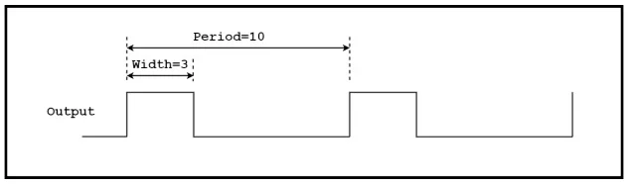
PWM
PWM timers are commonly used for motion control and dimming LEDs. Examples of these applications are included here.
Duty Cycle
Duty cycle is the amount of time a digital signal is in the “active” state relative to the period of the signal. Duty cycle is usually given as a percentage.
For example, a perfect square wave with equal high time and low time has a duty cycle of 50%. Here is a diagram showing duty cycle in a general way.
If active high, the duty cycle is
(Width ÷ Period) ✕ 100 ＝ (3 ÷ 10) ✕ 100 ＝ 30%
If we define the signal as active low,
the duty cycle is 70%.
Notes:
https://www.keil.com/pack/doc/CMSIS/Core/html/group__SysTick__gr.html

Slide 57
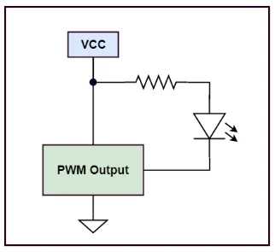
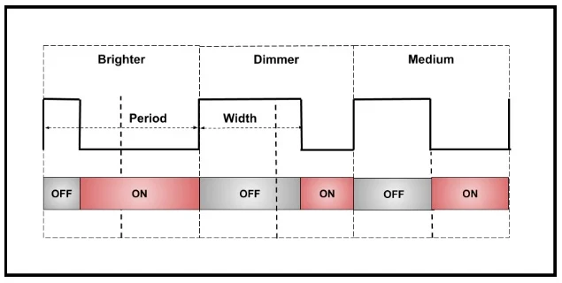
Controlling LED Intensity with a PWM Timer
The LED is on when the timer output is low and off when the output is high. The timer creates a rapidly changing output which turns the LED on and off fast enough, so the eye averages the “on” time and perceives a change in intensity and not blinking on and off.

Slide 58
UART
58
| NXP | Presentation title can go here

Slide 59
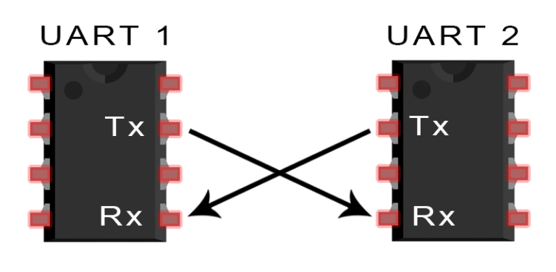
UART
UART stands for Universal Asynchronous Receiver/Transmitter. It’s a physical circuit in a microcontroller, or a stand-alone IC. A UART’s main purpose is to transmit and receive serial data.
In UART communication, two UARTs communicate directly with each other. The transmitting UART converts parallel data from a controlling device like a CPU into serial form, transmits it in serial to the receiving UART, which then converts the serial data back into parallel data for the receiving device. Only two wires are needed to transmit data between two UARTs. Data flows from the Tx pin of the transmitting UART to the Rx pin of the receiving UART:
Notes:
https://www.circuitbasics.com/basics-uart-communication/

Slide 60
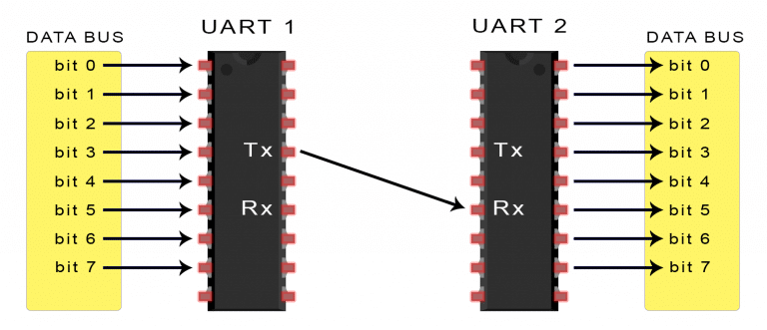
UART
The UART that is going to transmit data receives the data from a data bus. The data bus is used to send data to the UART by another device like a CPU, memory, or microcontroller. Data is transferred from the data bus to the transmitting UART in parallel form. After the transmitting UART gets the parallel data from the data bus, it adds a start bit, a parity bit, and a stop bit, creating the data packet. Next, the data packet is output serially, bit by bit at the Tx pin. The receiving UART reads the data packet bit by bit at its Rx pin. The receiving UART then converts the data back into parallel form and removes the start bit, parity bit, and stop bits. Finally, the receiving UART transfers the data packet in parallel to the data bus on the receiving end:

Slide 61
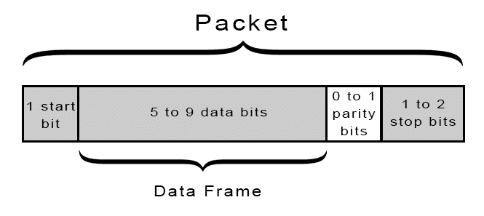
UART transmitted data is organized into packets. Each packet contains 1 start bit, 5 to 9 data bits (depending on the UART), an optional parity bit, and 1 or 2 stop bits:

Slide 62
UART
Start Bit
The UART data transmission line is normally held at a high voltage level when it’s not transmitting data. To start the transfer of data, the transmitting UART pulls the transmission line from high to low for one clock cycle. When the receiving UART detects the high to low voltage transition, it begins reading the bits in the data frame at the frequency of the baud rate.
Data Frame
The data frame contains the actual data being transferred. It can be 5 bits up to 8 bits long if a parity bit is used. If no parity bit is used, the data frame can be 9 bits long. In most cases, the data is sent with the least significant bit first.
Parity
Parity describes the evenness or oddness of a number. The parity bit is a way for the receiving UART to tell if any data has changed during transmission. Bits can be changed by electromagnetic radiation, mismatched baud rates, or long distance data transfers. After the receiving UART reads the data frame, it counts the number of bits with a value of 1 and checks if the total is an even or odd number. If the parity bit is a 0 (even parity), the 1 bits in the data frame should total to an even number. If the parity bit is a 1 (odd parity), the 1 bits in the data frame should total to an odd number. When the parity bit matches the data, the UART knows that the transmission was free of errors. But if the parity bit is a 0, and the total is odd; or the parity bit is a 1, and the total is even, the UART knows that bits in the data frame have changed.
Stop Bits
To signal the end of the data packet, the sending UART drives the data transmission line from a low voltage to a high voltage for at least two bit durations.

Slide 63
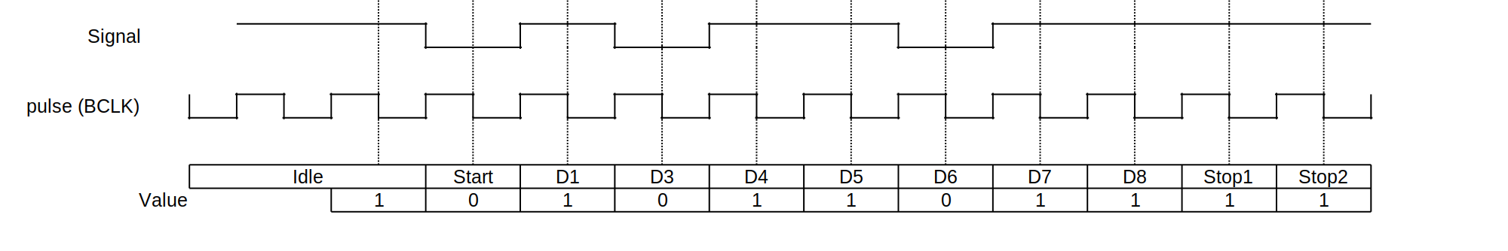
UART SIGNALS
Example of a UART frame. In this diagram, one byte is sent, consisting of a start bit, followed by eight data bits (D0-7), and two stop bit, for a 11-bit UART frame. The number of data and formatting bits, the presence or absence of a parity bit, the form of parity (even or odd) and the transmission speed must be pre-agreed by the communicating parties. The "stop bit" is actually a "stop period"; the stop period of the transmitter may be arbitrarily long. It cannot be shorter than a specified amount, usually 1 to 2 bit times. The receiver requires a shorter stop period than the transmitter. At the end of each data frame, the receiver stops briefly to wait for the next start bit. It is this difference which keeps the transmitter and receiver synchronized. BCLK = Base Clock
Notes:
https://en.wikipedia.org/wiki/Universal_asynchronous_receiver-transmitter

Slide 64

TESTING
64
| NXP | Presentation title can go here

Slide 65

What is testing
Software testing is the process of evaluating and verifying that a software product or application does what it is supposed to do. The benefits of testing include preventing bugs, reducing development costs and improving performance.

Slide 66
Types of testing
There are many different types of software tests, each with specific objectives and strategies:
Acceptance testing
Integration testing
Unit testing
Functional testing
Performance testing
Regression testing
Stress testing
Usability testing
In each case, validating base requirements is a critical assessment.
Even a simple application can be subject to a large number and variety of tests. Testing effectiveness is optimized by running the fewest number of tests to find the largest number of defects.
Notes:
There are many different types of software tests, each with specific objectives and strategies:
Acceptance testing: Verifying whether the whole system works as intended.
Integration testing: Ensuring that software components or functions operate together.
Unit testing: Validating that each software unit performs as expected. A unit is the smallest testable component of an application.
Functional testing: Checking functions by emulating business scenarios, based on functional requirements. Black-box testing is a common way to verify functions.
Performance testing: Testing how the software performs under different workloads. Load testing, for example, is used to evaluate performance under real-life load conditions.
Regression testing: Checking whether new features break or degrade functionality. Sanity testing can be used to verify menus, functions and commands at the surface level, when there is no time for a full regression test.
Stress testing: Testing how much strain the system can take before it fails. Considered to be a type of non-functional testing.
Usability testing: Validating how well a customer can use a system or web application to complete a task.
In each case, validating base requirements is a critical assessment. Just as important, exploratory testing helps a tester or testing team uncover hard-to-predict scenarios and situations that can lead to software errors.
Even a simple application can be subject to a large number and variety of tests. A test management plan helps to prioritize which types of testing provide the most value – given available time and resources. Testing effectiveness is optimized by running the fewest number of tests to find the largest number of defects.

Slide 67
History of testing
Software testing arrived alongside the development of software, which had its beginnings just after the second world war. Computer scientist Tom Kilburn is credited with writing the first piece of software, which debuted on June 21, 1948, at the University of Manchester in England. It performed mathematical calculations using machine code instructions.
Debugging was the main testing method at the time and remained so for the next two decades. By the 1980s, development teams looked beyond isolating and fixing software bugs to testing applications in real-world settings. It set the stage for a broader view of testing, which encompassed a quality assurance process that was part of the software development life cycle.
“In the 1990s, there was a transition from testing to a more comprehensive process called quality assurance, which covers the entire software development cycle and affects the processes of planning, design, creation and execution of test cases, support for existing test cases and test environments,” says Alexander Yaroshko in his post on the uTest developer site.
“Testing had reached a qualitatively new level, which led to the further development of methodologies, the emergence of powerful tools for managing the testing process and test automation tools.”

Slide 68
Continuous testing
Continuous testing
Software testing has traditionally been separated from the rest of development. It is often conducted later in the software development life cycle after the product build or execution stage. A tester may only have a small window to test the code – sometimes just before the application goes to market.
Doing test activities earlier in the cycle helps keep the testing effort at the forefront rather than as an afterthought to development. Earlier software tests also mean that defects are less expensive to resolve.
Many development teams now use a methodology known as continuous testing. It is part of a DevOps approach – where development and operations collaborate over the entire product life cycle. The aim is to accelerate software delivery while balancing cost, quality and risk. With this testing technique, teams don’t need to wait for the software to be built before testing starts. They can run tests much earlier in the cycle to discover defects sooner, when they are easier to fix.
Example of a Software development flow and how Continuous Integration/Continuous Development could help:
https://github.com/electron/electron/pull/38776

Slide 69
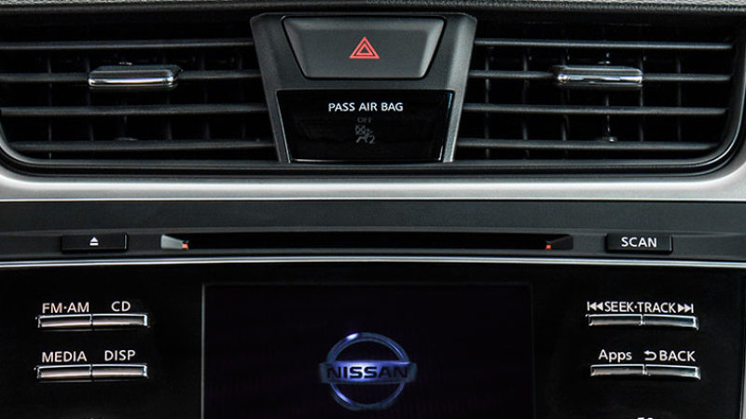
Why is testing important
Few can argue against the need for quality control when developing software. Late delivery or software defects can damage a brand’s reputation — leading to frustrated and lost customers. In extreme cases, a bug or defect can degrade interconnected systems or cause serious malfunctions.
Consider Nissan having to recall over 1 million cars due to a software defect in the airbag sensor detectors. Or a software bug that caused the failure of a USD 1.2 billion military satellite launch. The numbers speak for themselves. Software failures in the US cost the economy USD 1.1 trillion in assets in 2016. What’s more, they impacted 4.4 billion customers.
Though testing itself costs money, companies can save millions per year in development and support if they have a good testing technique and QA processes in place.
Notes:
Early software testing uncovers problems before a product goes to market. The sooner development teams receive test feedback, the sooner they can address When development leaves ample room for testing, it improves software reliability and high-quality applications are delivered with few errors. A system that meets or even exceeds customer expectations leads to potentially more sales and greater market share.

Slide 70
Best practices
Software testing follows a common process. Tasks or steps include defining the test environment, developing test cases, writing scripts, analyzing test results and submitting defect reports.
Testing can be time-consuming. Manual testing or ad-hoc testing may be enough for small builds. However, for larger systems, tools are frequently used to automate tasks. Automated testing helps teams implement different scenarios, test differentiators (such as moving components into a cloud environment), and quickly get feedback on what works and what doesn't.
A good testing approach encompasses the application programming interface (API), user interface and system levels. As well, the more tests that are automated, and run early, the better. Some teams build in-house test automation tools. However, vendor solutions offer features that can streamline key test management tasks such as:
Continuous testing
Configuration management
Service virtualization
Defect or bug tracking
Metrics and reporting
Notes:
Continuous testing: Project teams test each build as it becomes available. This type of software testing relies on test automation that is integrated with the deployment process. It enables software to be validated in realistic test environments earlier in the process – improving design and reducing risks.
Configuration management: Organizations centrally maintain test assets and track what software builds to test. Teams gain access to assets such as code, requirements, design documents, models, test scripts and test results. Good systems include user authentication and audit trails to help teams meet compliance requirements with minimal administrative effort.
Service virtualization: Testing environments may not be available, especially early in code development. Service virtualization simulates the services and systems that are missing or not yet completed, enabling teams to reduce dependencies and test sooner. They can reuse, deploy and change a configuration to test different scenarios without having to modify the original environment.
Defect or bug tracking: Monitoring defects is important to both testing and development teams for measuring and improving quality. Automated tools allow teams to track defects, measure their scope and impact, and uncover related issues.
Metrics and reporting: Reporting and analytics enable team members to share status, goals and test results. Advanced tools integrate project metrics and present results in a dashboard. Teams quickly see the overall health of a project and can monitor relationships between test, development and other project elements.

Slide 71
Metrics and reporting
Performance data
Time measurement, memory consumption(stack, code size, heap etc.)
Make sure project performance is withing business/customer expectations
Code Coverage
Metric that shows how much code is being “touched” by testing
Static analysis
There are tools that can help us spot common issues cppcheck, MISRA etc.
Because we are in an embedded world some of the above might need to be created from scratch by the team in order to enable these measurements.

Slide 72
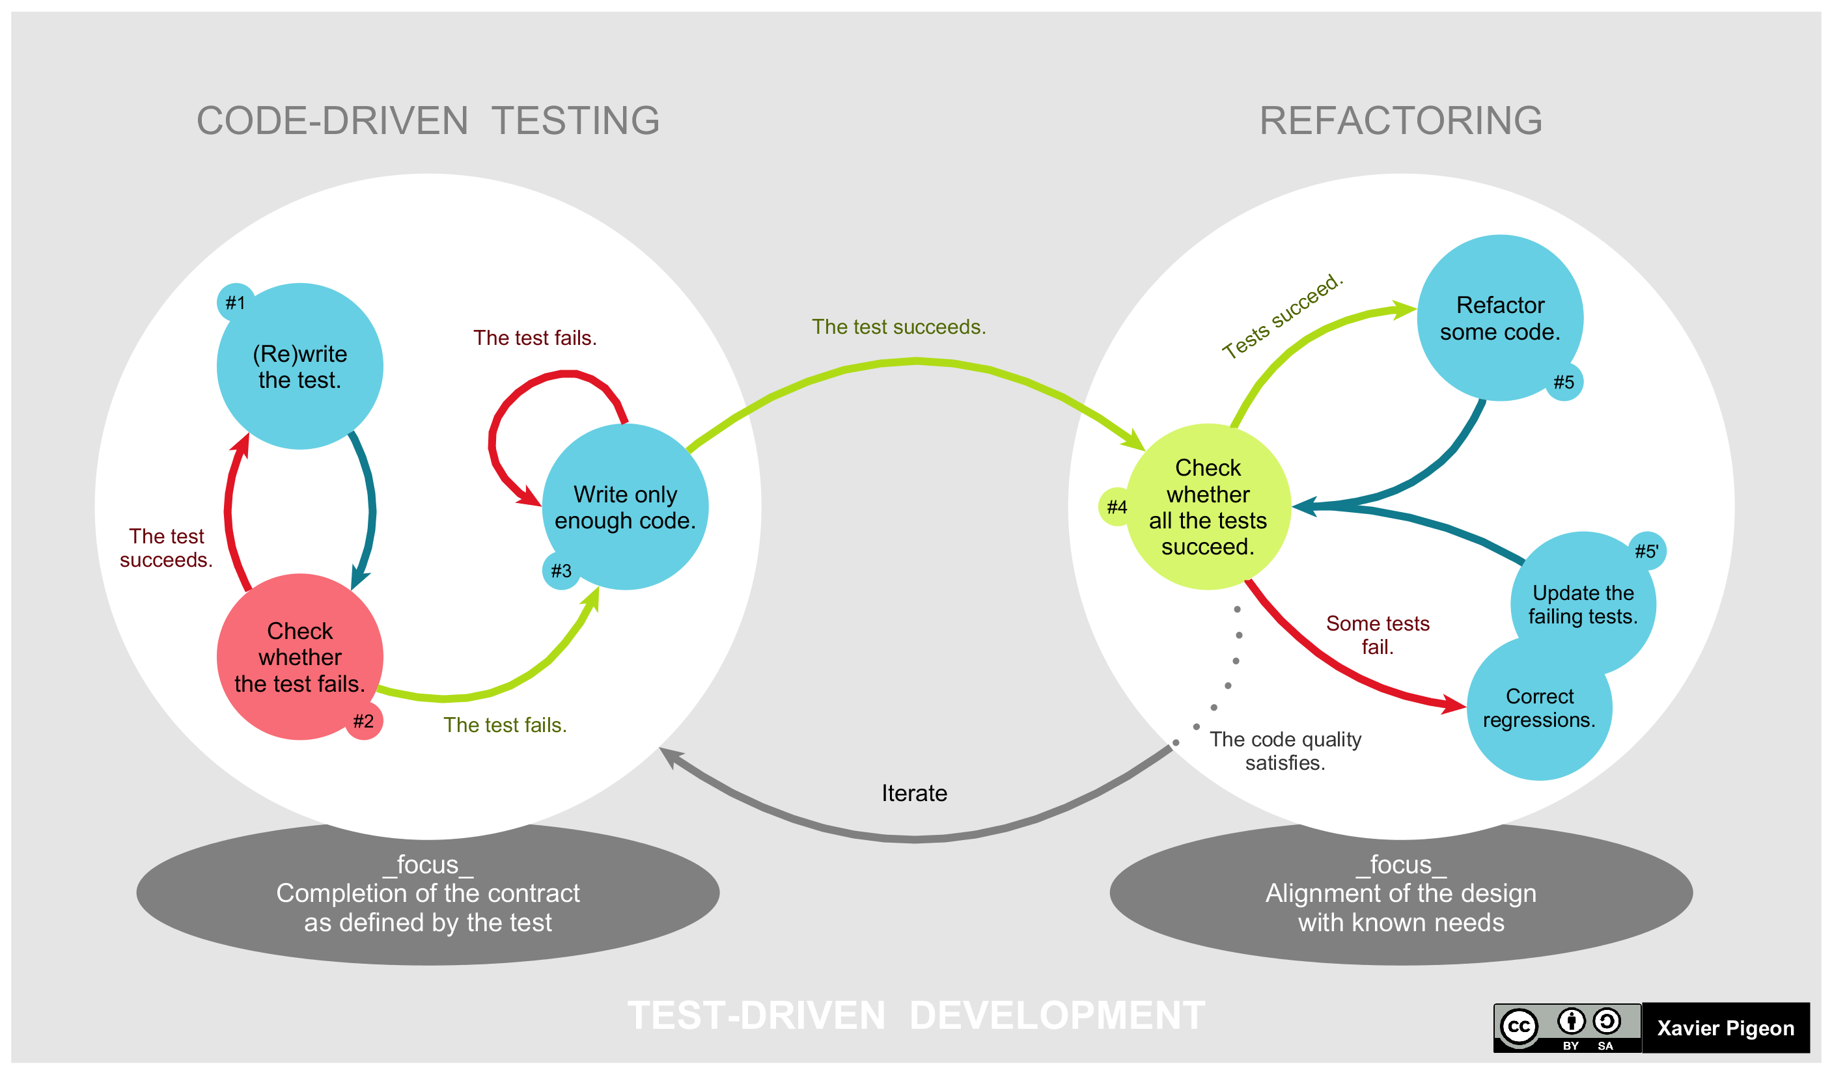
Test driven development

Slide 73
Complexity of testing
Embedded devices create more complexity in testing because of the device itself is rather limited in resources and has constraints that normal systems do not. Some examples would be:
Hardware dependency
Software vs hardware defects
Compliance testing
Reproducible defects
Not easy to automate
Software updates might be impossible
Notes:
HARDWARE DEPENDENCY
Hardware dependency is among the leading challenges faced during embedded software testing due to limited access to hardware. In such case, Emulators/Simulators are used to perform testing in real time embedded systems. Emulators and Simulators may not accurately represent the behavior of the actual device and could give a false sense of application's usability and system performance.
SOTWARE VS HARDWARE DEFECTS
Another aspect is when software is developed for a freshly created hardware, high ratio of hardware defects can be identified during the testing process. Identified defect may be related to the hardware, not only software. What’s worse is that the software may work fine with one variant of the hardware and doesn’t work with another. That’s a challenge for the testing process.
COMPLIANCE TESTING
Software failures in embedded devices can put people’s lives in danger. To minimize this danger, most of the medical, security, industrial and automotive devices has to go through different safety/security/features compliance testing. With short development life cycle and quick to market, it is essential to have proper test automation setup to quickly run through these compliance tests.
REPRODUCIBLE DEFECTS
Defects are harder to recreate/reproduce in the embedded system case. That forces the embedded testing procedure to esteem every defect occurrence much higher than in a customary case, besides to collect much information as could sensibly be required to adjust the system to discover the foundation of the defect. Joined with the extremely constrained troubleshoot capacities of the embedded products, gives us another test.
NOT EASY TO AUTOMATE
Automation testing in embedded system may become complex due to complexity of software development in which changes in hardware and software interfaces are common. Modular and extensible automated test environments can significantly reduce the influence of these changes. For this, it is mandatory to put the efforts for a fair design and continuous maintenance.

Slide 74
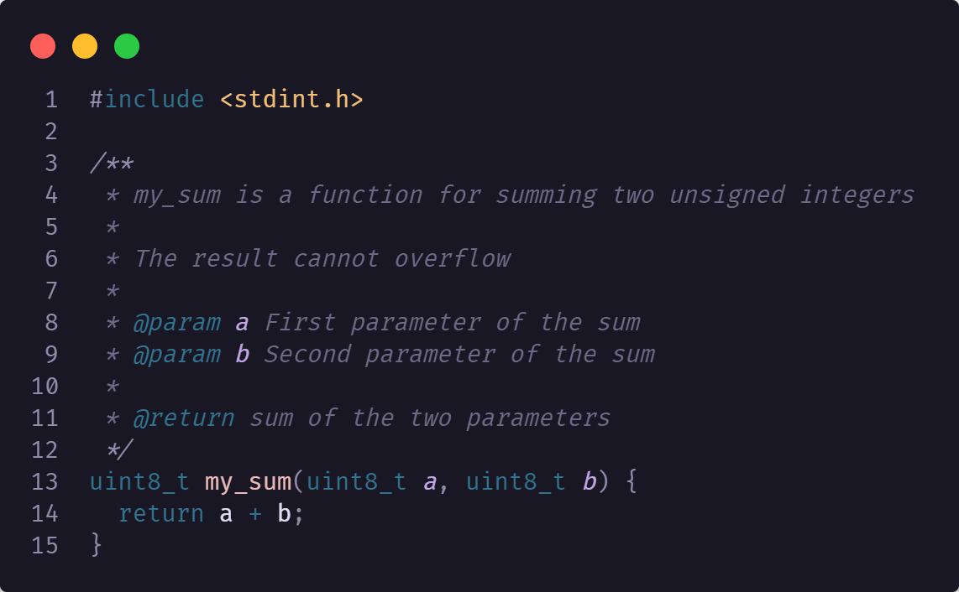
Example of function testing
For what scenarios do we need to test?

Slide 75
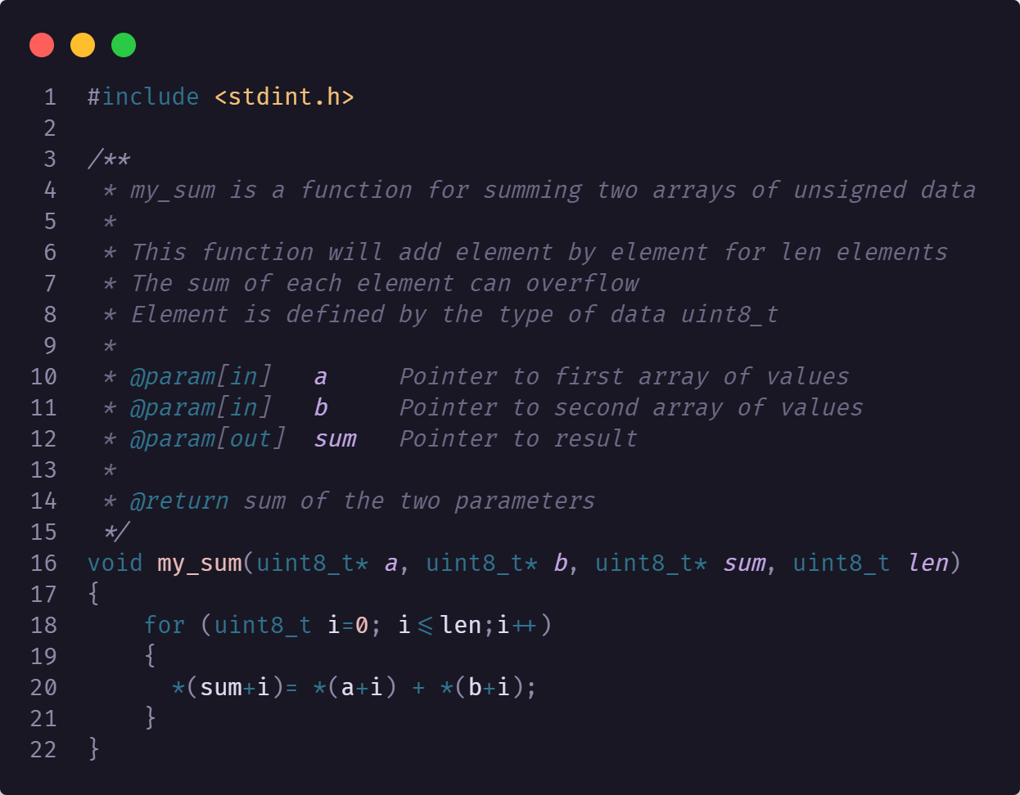
Example of function testing
For what scenarios do we need to test?

Slide 76
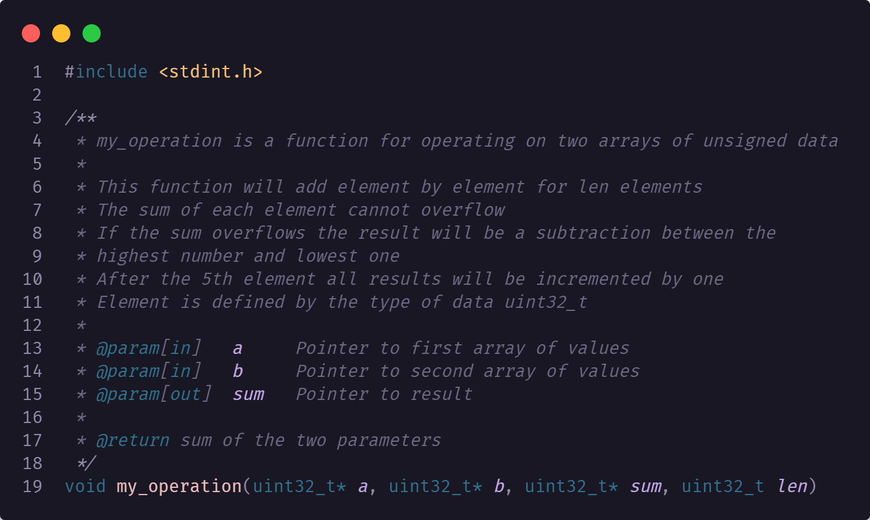
Example of function testing
For what scenarios do we need to test?

Slide 77
Mock interview

Slide 78
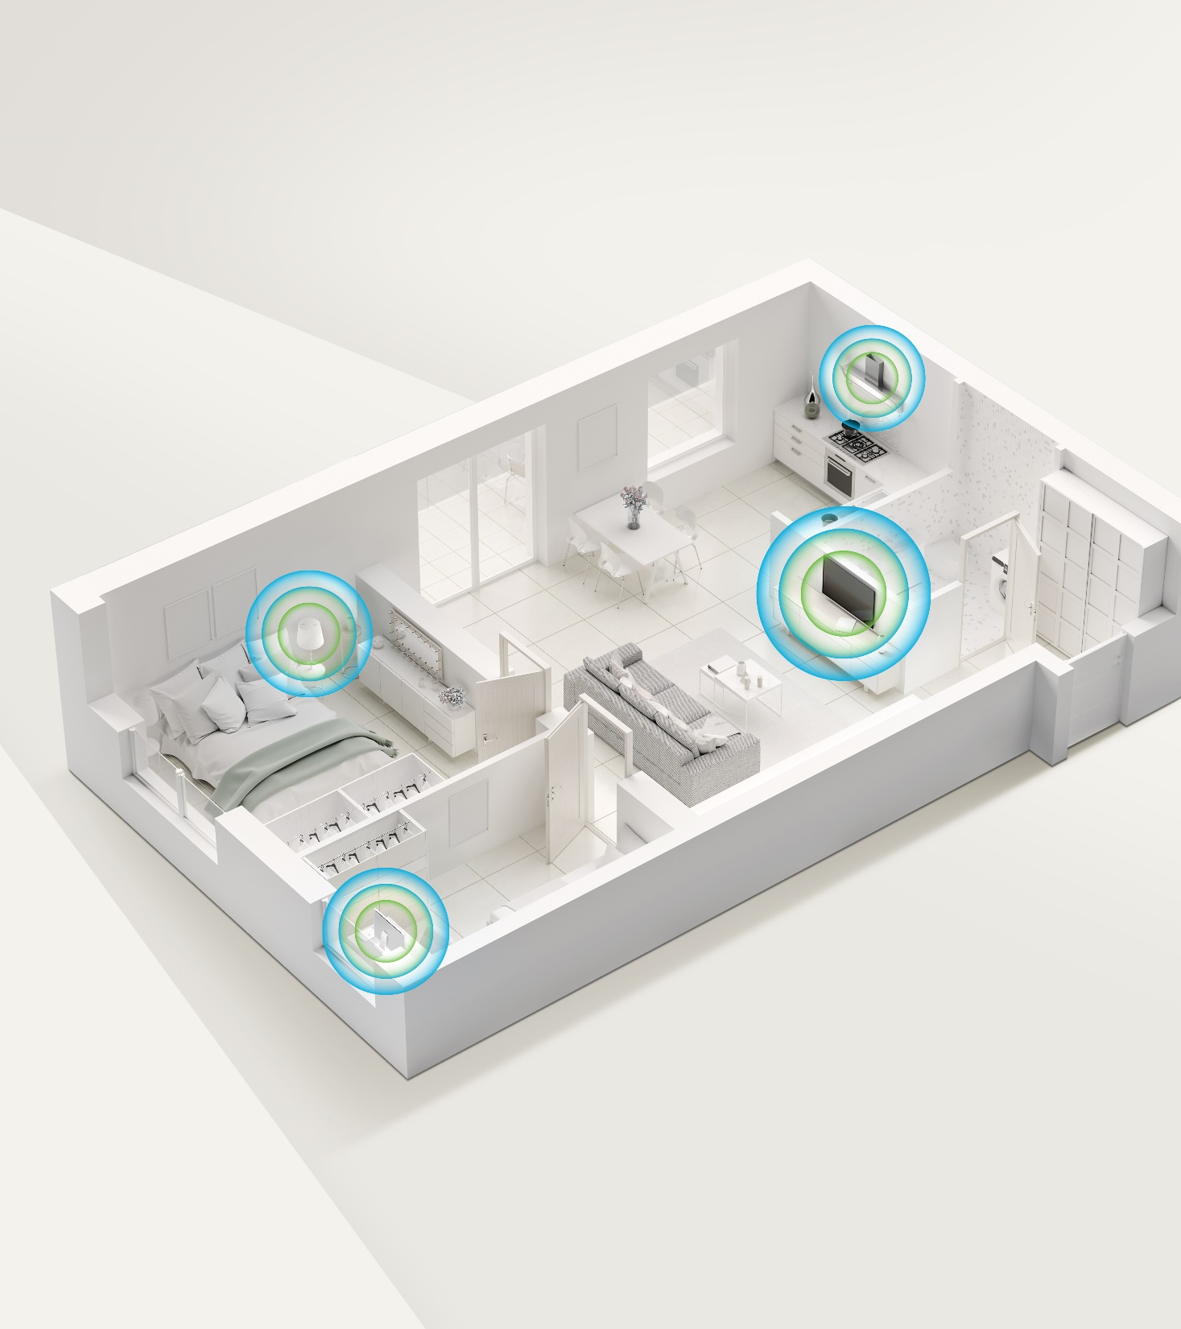
CRYPTOGRAPHY
78
| NXP | Presentation title can go here

Slide 79

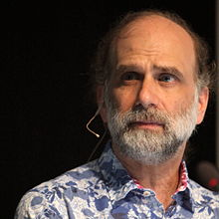
Cryptography
Cryptography is the science of using mathematics to encrypt and decrypt data.
Phil Zimmermann
Cryptography is the art and science of keeping messages secure.
Bruce Schneier
The art and science of concealing the messages to introduce secrecy in information security is recognized as cryptography.

Slide 80
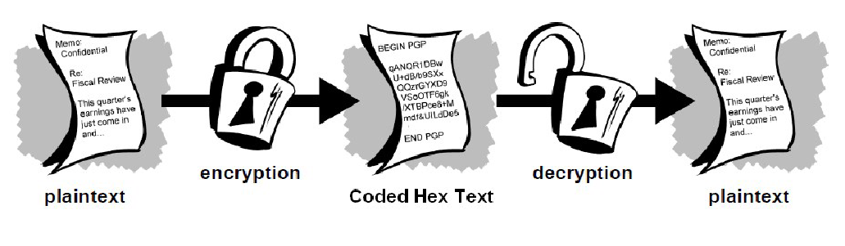
TerminologY
A message is plaintext (sometimes called cleartext). The process of disguising a message in such a way as to hide its substance is encryption. An encrypted message is ciphertext. The process of turning ciphertext back into plaintext is decryption.
A cipher (or cypher) is an
algorithm for performing
encryption or decryption—a
series of well-defined steps
that can be followed as a
procedure.

Slide 81
TerminologY
A cryptosystem is an implementation of cryptographic techniques and their accompanying infrastructure to provide information security services. A cryptosystem is also referred to as a cipher system. The various components of a basic cryptosystem are as follows:
Plaintext
Encryption Algorithm
Ciphertext
Decryption Algorithm
Encryption Key
Decryption Key

Slide 82
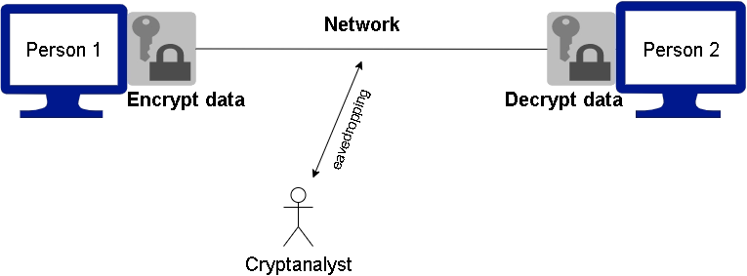
TerminologY
While cryptography is the science of securing data, cryptanalysis is the science of analyzing and breaking secure communication. Classical cryptanalysis involves an interesting combination of analytical reasoning, application of mathematical tools, pattern finding, patience, determination, and luck. Cryptanalysts are also called attackers.
Cryptology embraces both cryptography and cryptanalysis.

Slide 83
History of Cryptography
As civilizations evolved, human beings got organized in tribes, groups, and kingdoms.
This led to the emergence of ideas such as power, battles, supremacy, and politics.
These ideas further fueled the natural need of people to communicate secretly with selective recipient which in turn ensured the continuous evolution of cryptography as well.
The roots of cryptography are found in Roman and Egyptian civilizations.

Slide 84
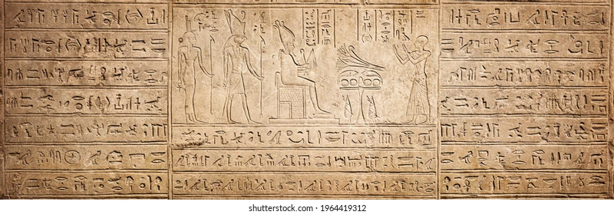
History of Cryptography
Hieroglyph
The first known evidence of cryptography can be traced to the use of ‘hieroglyph’. Some 4000 years ago, the
Egyptians used to communicate by messages written in hieroglyph

Slide 85

History of Cryptography
Caesar Shift Cipher
Caesar Shift Cipher, relies on shifting the letters of a message by an agreed number (three was a common choice), the recipient of this message would then shift the letters back by the same number and obtain the original message.
The Caesar cipher is named after Julius Caesar , who used it with a shift of three to protect messages of military significance.

Slide 86

History of Cryptography
PLAINTEXT : internet society ghana chapter
CYPHERTEXT : lqwhuqhw vrflhwb jkdqd fkdswhu

Slide 87
Goal and Services
Goal: The primary goal of cryptography is to secure important data on the hard disk or as it passes through a medium that may not be secure itself. Usually, that medium is a computer network.
Services: Cryptography can provide the following services:
•Confidentiality (secrecy)
•Integrity (anti-tampering)
•Authentication
•Non-repudiation.

Slide 88

Confidentiality (secrecy)
• Ensuring that no one can read the message except the intended receiver
• Data is kept secret from those without the proper credentials, even if that data travels through an insecure medium
Integrity (anti-tampering)
• Assuring the receiver that the received message has not been altered in
any way from the original.

Slide 89

Goal and Services
Authentication
Cryptography can help establish identity for authentication purposes
The process of proving one's identity. (The primary forms of host-to-host authentication on the Internet today are name-based or address-based, both of which are notoriously weak.)
Non-repudiation
A mechanism to prove that the sender really sent this message

Slide 90

Types of Cryptography(Simplified)
Types of Cryptography
Symmetric Key Cryptography
Asymmetric Key Cryptography
Hash Functions

Slide 91
Symmetric Key Cryptography
Also known as Secret Key Cryptography or Conventional Cryptography, Symmetric Key
Cryptography is an encryption system in which the sender and receiver of a message share a single, common key that is used to encrypt and decrypt the message.
The Algorithm use is also known as a secret key algorithm or sometimes called a symmetric algorithm
A key is a piece of information (a parameter) that determines the functional output of a cryptographic algorithm or cipher.

Slide 92

Symmetric Key Cryptography
The key for encrypting and decrypting the file had to be known to all the recipients. Else, the message could not be decrypted by conventional means

Slide 93
Symmetric Key Cryptography
Data Encryption Standard (DES)
The Data Encryption Standard was published in 1977 by the US National Bureau of Standards.
DES uses a 56-bit key and maps a 64-bit input block of plaintext onto a 64-bit output block of ciphertext. 56 bits is a rather small key for today's computing power.
Triple DES
Triple DES was the answer to many of the shortcomings of DES. Since it is based on the DES algorithm, it is very easy to modify existing software to use Triple DES. It also has the advantage of proven reliability and a longer key length that eliminates many of the shortcut attacks that can be used to reduce the amount of time it takes to break DES.

Slide 94
Symmetric Key Cryptography
Advanced Encryption Standard (AES) (RFC3602)
Advanced Encryption Standard (AES) is an encryption standard adopted by the U.S. government. The standard comprises three block ciphers, AES-128, AES-192 and AES-256, adopted from a larger collection originally published as Rijndael.
Each AES cipher has a 128-bit block size, with key sizes of 128, 192 and 256 bits, respectively. The AES ciphers have been analyzed extensively and are now used worldwide, as was the case with its predecessor, the Data Encryption Standard (DES).

Slide 95
Padding
Padding standards are mechanisms for appending some predefined values to messages. They are used with algorithms which deal with blocks of data. Typical examples of such operations are block symmetric ciphers. These algorithms work on the whole data blocks. Therefore, if a message length is not a multiple of the block size, a standard for adding some number of bytes to the end of the message is required.
The information which padding standard has been used, must be provided to the receiver. This allows them to determine (after decrypting the ciphertext) where the original message ends, and the unimportant pad bytes starts.
Using padding is a convenient way of making sure that encrypted data is of the correct size. The only drawback is the fact that even if the original message contains the correct number of bytes (a multiple of the block size), some padding must be added to fulfil the process and make sure that the receiver would be able to understand the message. Usually, a new dummy block must be added which will contain only the padding bytes.
There are a few padding types described below. The first two paddings are based on bits, whereas the others are based on bytes.

Slide 96
Padding examples
Zero Byte Padding
All padding bytes are zeros. This type of padding is rather unreliable (what if the data ends with zeros?) and should be use only if necessary in legacy applications.
0x10 0x11 0x36 0x67 0x38 0xBC 0x03 0x21 0xEF 0x00 0x00 0x00 0x10 0x11 0x36 0x67 0x38 0xBC 0x03 0x21 0x00 0x00 0x00 0x00
ANSI X9.23 Padding
The last byte of the padding (thus, the last byte of the block) is the number of pad bytes. All other bytes of the padding are zeros.
0x10 0x11 0x36 0x67 0x38 0xBC 0x03 0x21 0xEF 0x00 0x00 0x03

Slide 97
Key Management
Symmetric-key systems are simpler and faster; their main drawback is that the two parties must somehow exchange the key in a secure way and keep it secure after that.
Key Management caused nightmare for the parties using the symmetric key cryptography. They were worried about how to get the keys safely and securely across to all users so that the decryption of the message would be possible. This gave the chance for third parties to intercept the keys in transit to decode the top-secret messages. Thus, if the key was compromised, the entire coding system was compromised and a “Secret” would no longer remain a “Secret”.
This is why the “Public Key Cryptography” came into existence.

Slide 98

Block cipher Modes of operation
ECB ( electronic code book) it is a straightforward mode. Input data is sliced into multiple data blocks and then are encrypted independently. The biggest disadvantage is that same input block will result in same output block for same key. This means patterns may be detected in encrypted data.

Slide 99
Block cipher Modes of operation
CBC (cipher block chaining) XOR encrypted data block with next plaintext data to create diffusion in encrypted data. For first data block an IV (Initialization Vector is used).
IV doesn’t need to bee secret but the pair IV KEY must be unique.
Some mode of operation like CTR and OFB transform block cipher into stream cipher by encrypting IV and then XOR cipher output with plain data. Due to the XOR properties those mode of operation do not need a decryption algorithm to be implemented on system.
Some of operation mode are vulnerable to bit changes in encrypted data. This changes can come from transmissions error or from an attacker. In some case like CBC one bit change will lead to a change of corresponding byte in plain data and bad decryption of next block. This means that one change in IV for decrypting algorithm will can provide valid decrypted data, but content is modified.
To prevent this type of vulnerabilities we should use operation modes that provide authentication like CCM or GCM.
Notes:
https://www.devglan.com/online-tools/aes-encryption-decryption
IV 1: 1234567890123456
Plain text: My time is 10 pm
Key size: 256
Secret key: 12345678901234567890123456789012
IV 2: 1234567890123456

Slide 100

Block cipher Modes of operation

Slide 101
Key Management
Symmetric-key systems are simpler and faster; their main drawback is that the two parties must somehow exchange the key in a secure way and keep it secure after that.
Key Management caused nightmare for the parties using the symmetric key cryptography. They were worried about how to get the keys safely and securely across to all users so that the decryption of the message would be possible. This gave the chance for third parties to intercept the keys in transit to decode the top-secret messages. Thus, if the key was compromised, the entire coding system was compromised and a “Secret” would no longer remain a “Secret”.
This is why the “Public Key Cryptography” came into existence.

Slide 102
Block cipher Modes of operation
ECB ( electronic code book) it is a straightforward mode. Input data is sliced into multiple data blocks and then are encrypted independently. The biggest disadvantage is that same input block will result in same output block for same key. This means patterns may be detected in encrypted data.

Slide 103
Block cipher Modes of operation
CBC (cipher block chaining) XOR encrypted data block with next plaintext data to create diffusion in encrypted data. For first data block an IV (Initialization Vector is used).
IV doesn’t need to bee secret but the pair IV KEY must be unique.
Some mode of operation like CTR and OFB transform block cipher into stream cipher by encrypting IV and then XOR cipher output with plain data. Due to the XOR properties those mode of operation do not need a decryption algorithm to be implemented on system.
Some of operation mode are vulnerable to bit changes in encrypted data. This changes can come from transmissions error or from an attacker. In some case like CBC one bit change will lead to a change of corresponding byte in plain data and bad decryption of next block. This means that one change in IV for decrypting algorithm will can provide valid decrypted data, but content is modified.
To prevent this type of vulnerabilities we should use operation modes that provide authentication like CCM or GCM.
Notes:
https://www.devglan.com/online-tools/aes-encryption-decryption
IV 1: 1234567890123456
Plain text: My time is 10 pm
Key size: 256
Secret key: 12345678901234567890123456789012
IV 2: 1234567890123456

Slide 104
Block cipher Modes of operation

Slide 105
This was solved on April 26, 1994, cracked by an international effort via the internet with the use of 1600 workstations, mainframes, and supercomputers attacked the number for eight months before finding its Public key and its private key.
Encryption key = 9007
The message "first solver wins one hundred dollars".
Of course, the RSA algorithm is safe, as it would be incredibly difficult to gather up such international participation to commit malicious acts.

Slide 106

Hash Functions
A cryptographic hash function is a hash function that takes an arbitrary block of data and returns a fixed-size bit string, the cryptographic hash value, such that any (accidental or intentional) change to the data will (with very high probability) change the hash value. The data to be encoded are often called the message, and the hash value is sometimes called the message digest or simply digest.

Slide 107
Hash Functions
The ideal cryptographic hash function has four main properties:
it is easy to compute the hash value for any given message
it is infeasible to generate a message that has a given hash
it is infeasible to modify a message without changing the hash
it is infeasible to find two different messages with the same hash.

Slide 108


Slide 109

Collusion Discovery
In March 2005 Xiaoyun Wang and Hongbo Yu of Shandong University in China created a pair of files that share the same MD5 checksum hence prove that there is a collusion when using MD5

Slide 110
SHA
The Secure Hash Algorithm (SHA) hash functions are a set of cryptographic hash functions designed by the National Security Agency (NSA) and published by the NIST as a U.S. Federal Information Processing Standard.
SHA stands for Secure Hash Algorithm.
Because of the successful attacks on MD5, SHA-0 and theoretical attacks on SHA-1, NIST perceived a need for an alternative, dissimilar cryptographic hash, which became SHA-3.
In October 2012, the National Institute of Standards and Technology (NIST) chose the Keccak algorithm as the new SHA-3 standard.

Slide 111

Message Authentication Code (MAC)
MAC algorithm is a symmetric key cryptographic technique to provide message authentication. For establishing MAC process, the sender and receiver share a symmetric key K.
Essentially, a MAC is an encrypted checksum generated on the underlying message that is sent along with a message to ensure message authentication.
The process of using MAC for authentication is depicted in the following illustration −
Notes:
In the last chapter, we discussed the data integrity threats and the use of hashing technique to detect if any modification attacks have taken place on the data.
Another type of threat that exist for data is the lack of message authentication. In this threat, the user is not sure about the originator of the message. Message authentication can be provided using the cryptographic techniques that use secret keys as done in case of encryption.
Establishment of Shared Secret.
It can provide message authentication among pre-decided legitimate users who have shared key.
This requires establishment of shared secret prior to use of MAC.

Slide 112

Asymmetric Key Cryptography
Asymmetric cryptography , also known as Public-key cryptography, refers to a cryptographic algorithm which requires two separate keys, one of which is private and one of which is public. The public key is used to encrypt the message and the private one is used to decrypt the message.

Slide 113


Slide 114
Asymmetric Key Cryptography
Public Key Cryptography is a very advanced form of cryptography.
Officially, it was invented by Whitfield Diffie and Martin Hellman in 1975.
The basic technique of public key cryptography was first discovered in 1973 by the British Clifford Cocks of Communications-Electronics Security Group (CESG) of (Government Communications Headquarters - GCHQ) but this was a secret until 1997

Slide 115
RSA
RSA (Rivest, Shamir and Adleman who first publicly described it in 1977) is an algorithm for public-key cryptography. It is the first algorithm known to be suitable for signing as well as encryption, and one of the first great advances in public key cryptography.
RSA is widely used in electronic commerce protocols and is believed to be secure given sufficiently long keys and the use of up-to-date implementations.
Notes:
https://en.wikipedia.org/wiki/Trapdoor_function
In this example, the inverse d of e modulo ϕ ( n ) (Euler's totient function of n ) is the trapdoor:
f ( x ) = x e mod n . If the factorization of n = p q is known, then ϕ ( n ) = ( p − 1 ) ( q − 1 ) can be computed. With this the inverse d of e can be computed d = e − 1 mod ϕ ( n ) , and then given y = f ( x ) , we can find x = y d mod n = x e d mod n = x mod n . Its hardness follows from the RSA assumption.^{[7]}

